Slide 1


Work In Progress
CLECKSHOPHUB

Slide 2
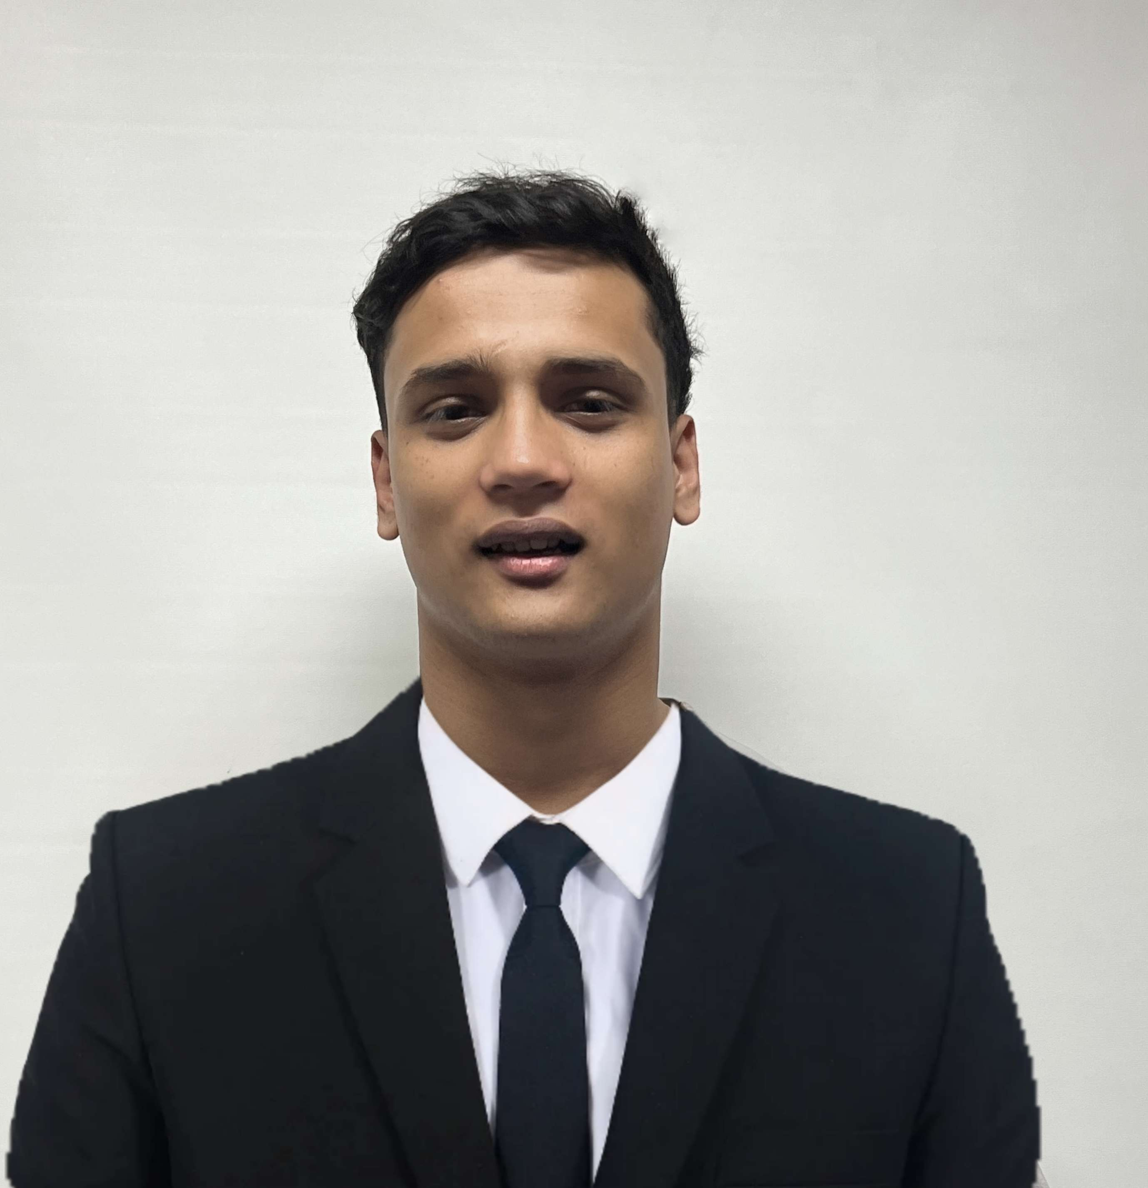



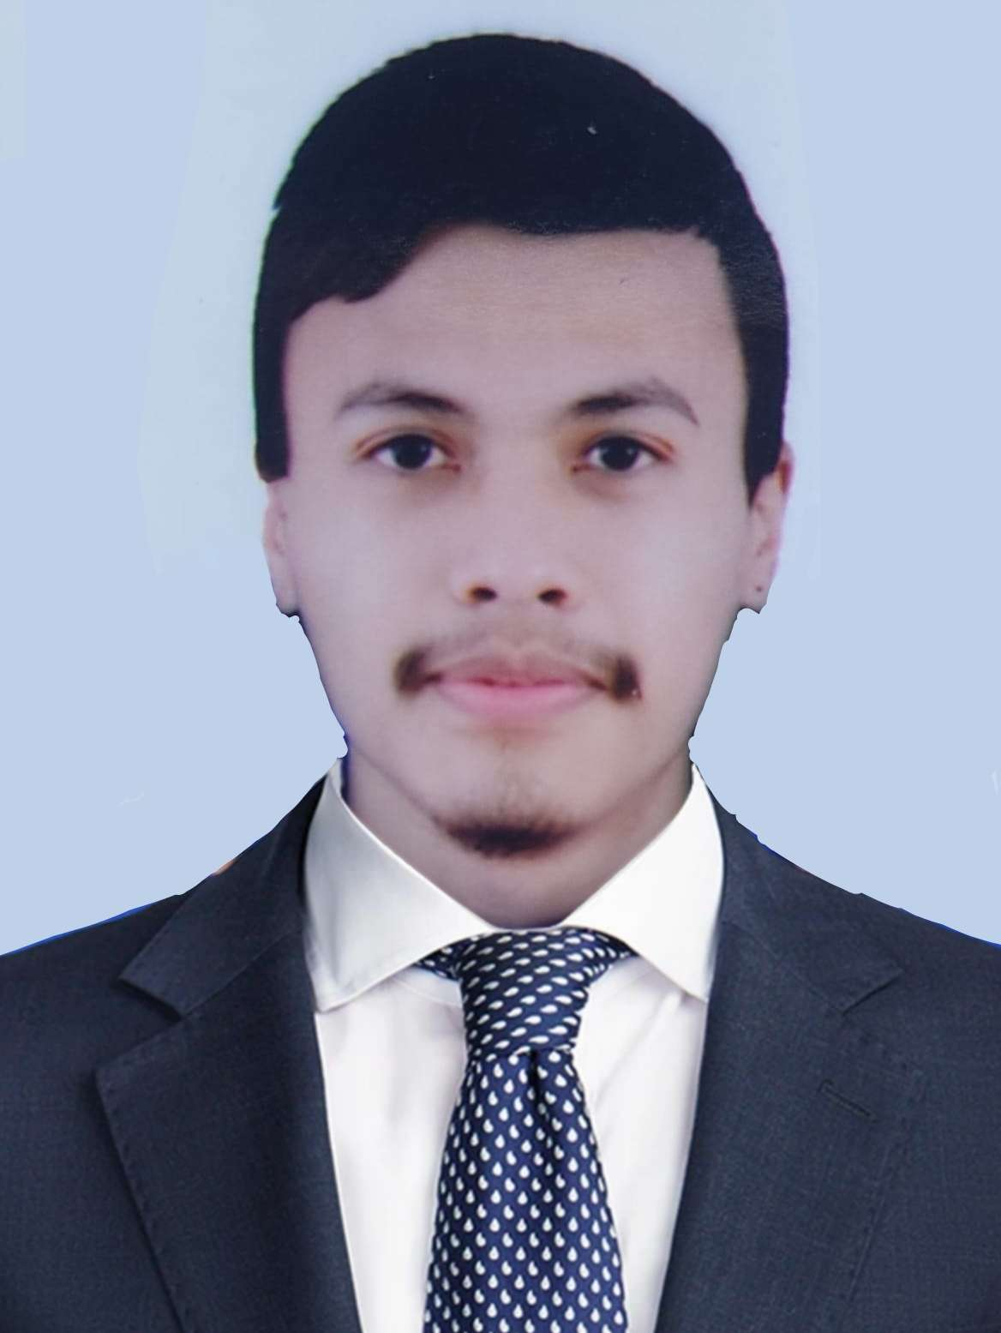
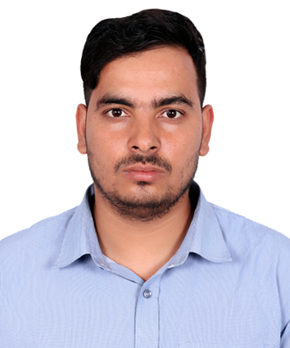
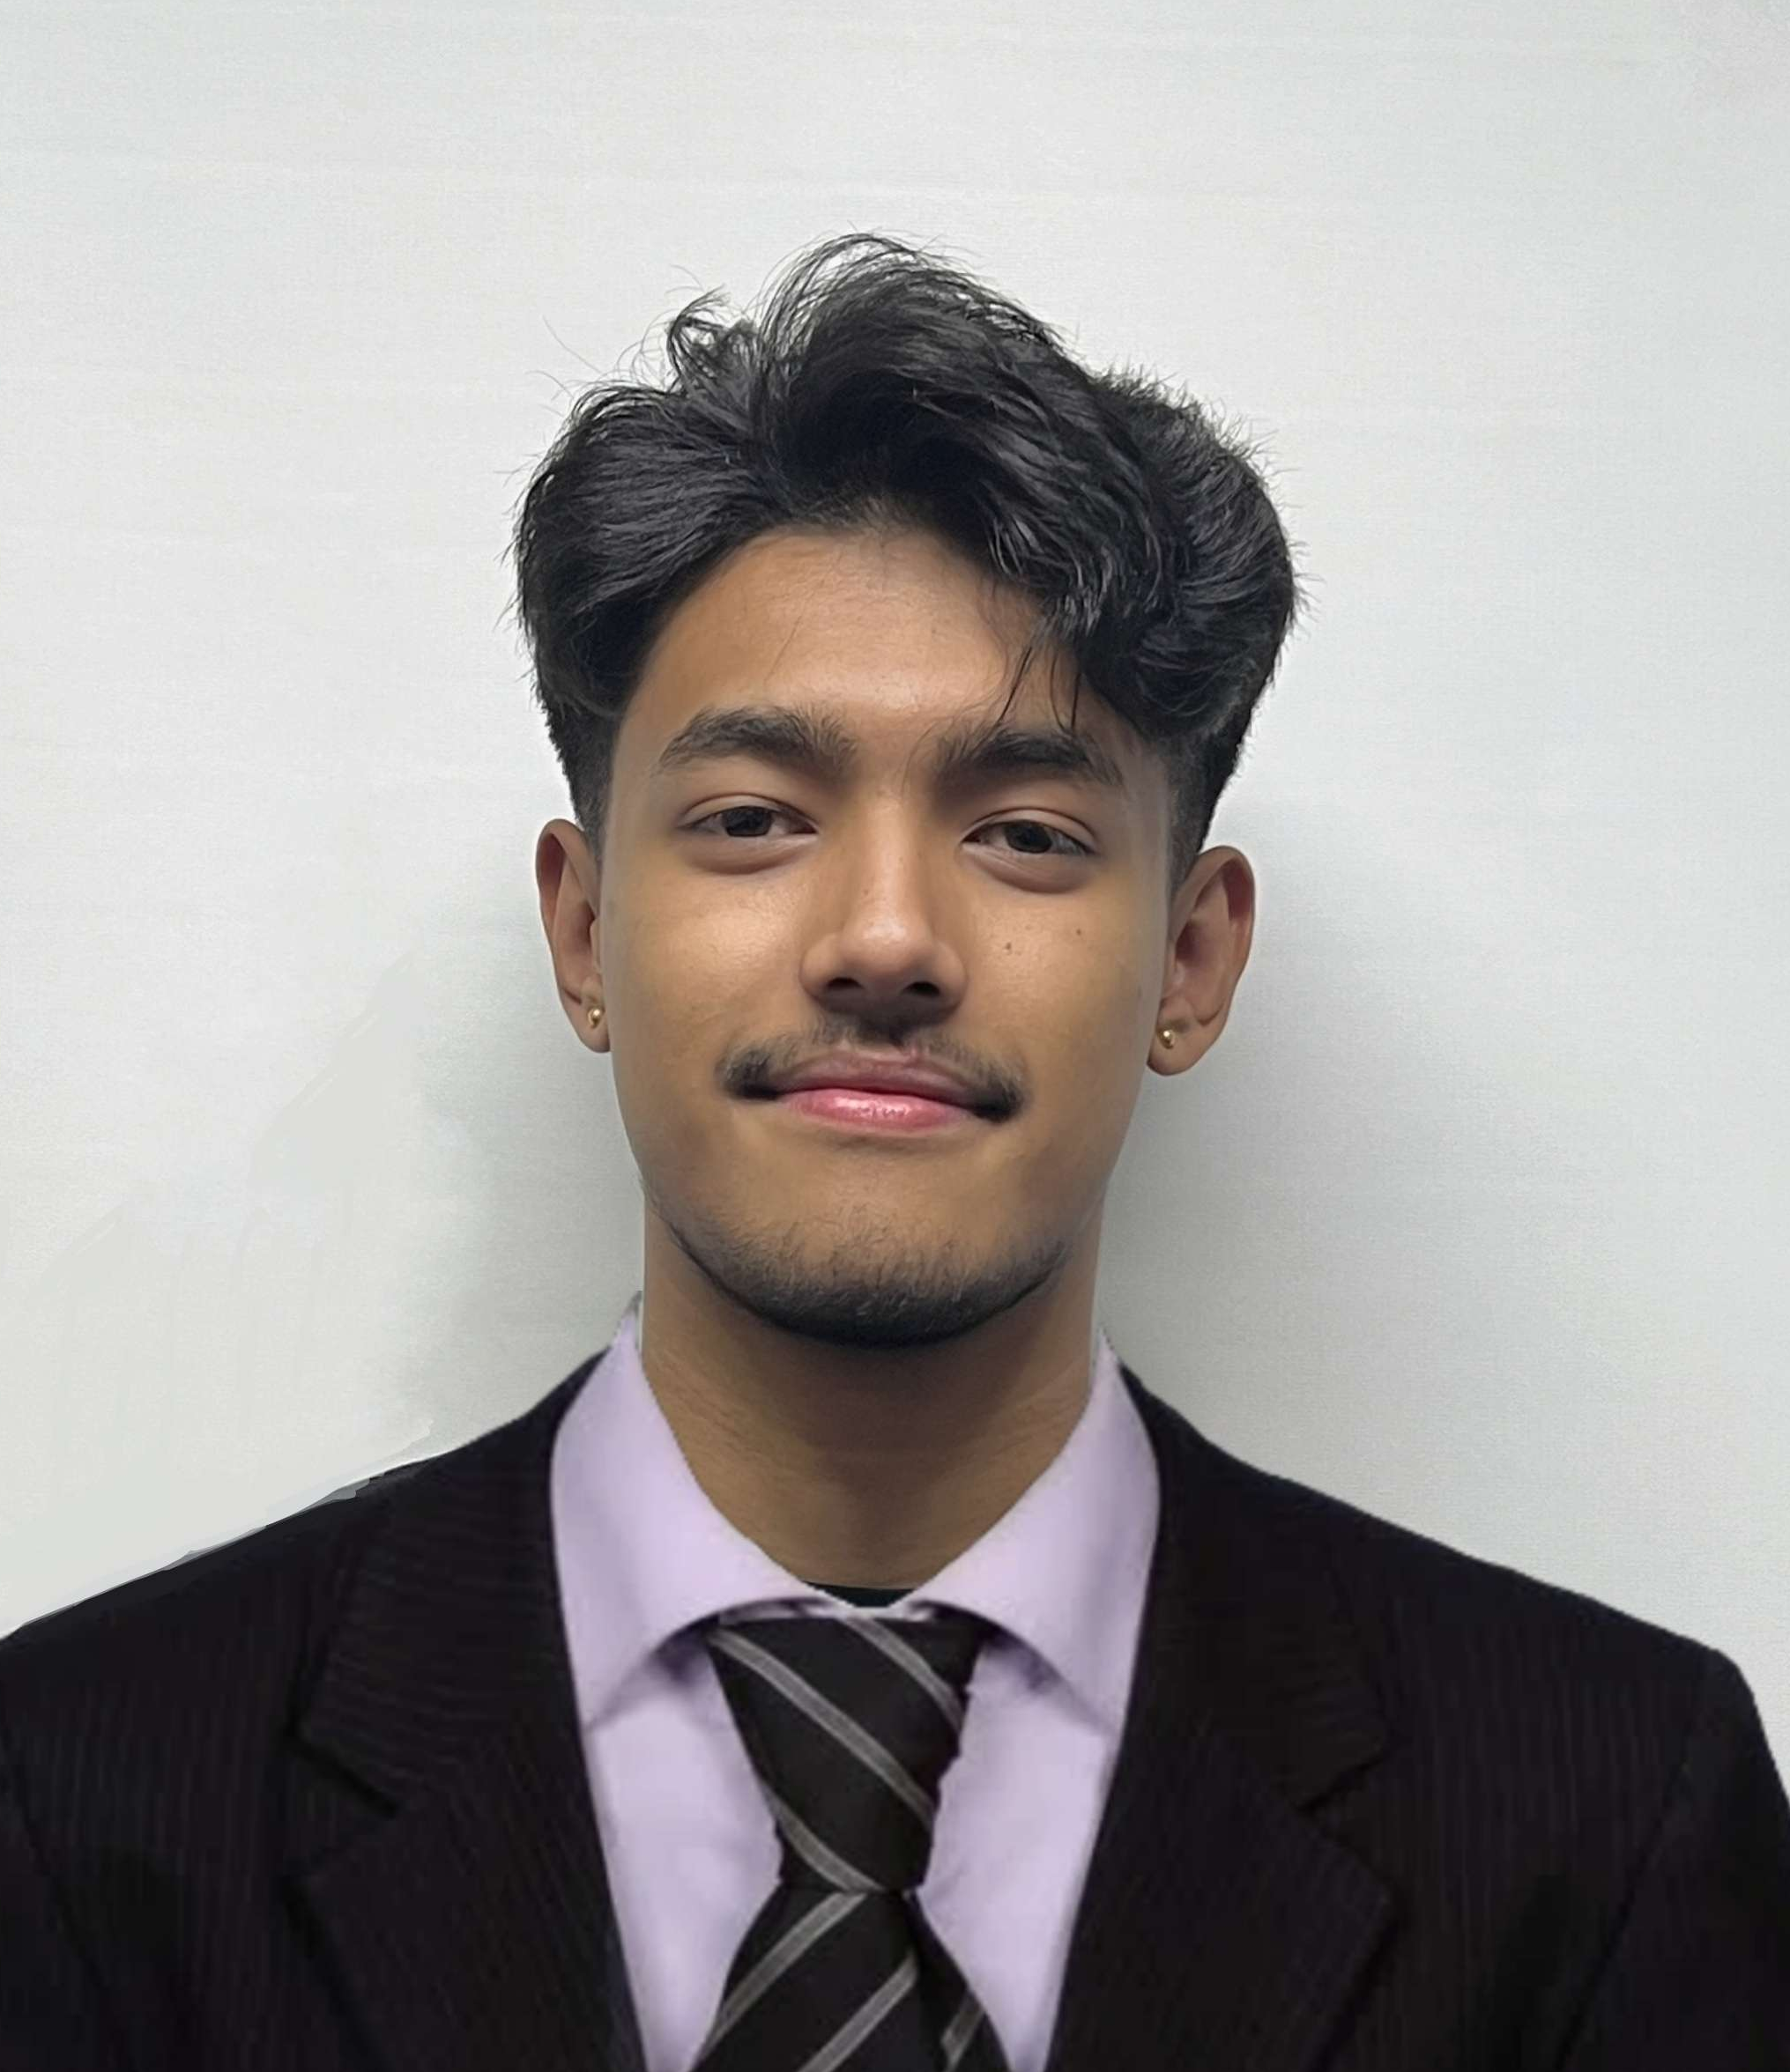
Meet our team
Abhishek Poudel
Plant
Shasank Shrestha
Amulya Shrestha
Co-Ordinator
Resource Investigator
Soya Shrestha
Team Worker
Biliyas Maharjan
Team Worker
Sushan Bhandari
Implementer
Biraj Shrestha
Co-Ordinator

Slide 3



Project Phases
PLANNING PHASE
INITIATION PHASE
EXECUTION PHASE

Slide 4

TABLE OF CONTENT
Initiation Phase
Team Contract
Project Charter
Planning Phase
Belbin Analysis
Skill Audit
MS Project
Communication Tools
Execution Phase
Database Design
Use Case Diagram
Logo Design and Wireframe
Requirement Catalogue
Product Development
4

Slide 5

INITIATION PHASE
Project Charter
Team Contract
5

Slide 6
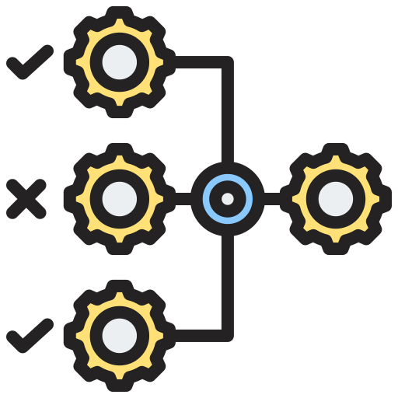





PROJECT CHARTER
Version Control
Estimated Budget
Project Justification
Duration
Project Scope
Roles and Responsibility

Slide 7
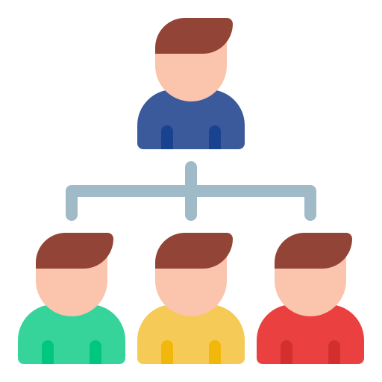





TEAM CONTRACT
Team Structure
Personal Accountability
Team Procedure
Consequences of breach of contract
Team Participation
Certification by team members

Slide 8
PLANNING PHASE
Belbin Analysis
Skill Audit
MS Project
Communication tools

Slide 9
Belbin Analysis
Team Members | Primary Role | Secondary Role | Least likely Role
Abhishek Poudel | Plant | Resource Investigator | Shaper
Amulya Shrestha | Resource Investigator | Plant | Shaper
Biliyas Maharjan | Team Worker | Implementer | Monitor Evaluator
Biraj Shrestha | Co-Ordinator | Complete Finisher | Plant
Shasank Shrestha | Co-Ordinator | Specialist | Complete Finisher
Soya Shrestha | Team Worker | Monitor Evaluator | Shaper
Sushan Bhandari | Implemeter | Co-Ordinator | Specialist

Slide 10
PHP
HTML
CSS
BOOTSTRAP
EXCEL
JAVA SCRIPT
GITHUB
DISCORD
FIGMA
VS CODE
MS PROJECT
ORACLE APEX
QSEE SUPERLITE
MS WORD
POWERPOINT
PHOTOSHOP
ILLUSTRATOR
SANDBOX
XAMPP
Skill Audit

Slide 11





MS PROJECT
TIMELINE
RESOURCE SHEET
TASK SHEET
GANTT CHART
CALENDAR

Slide 12
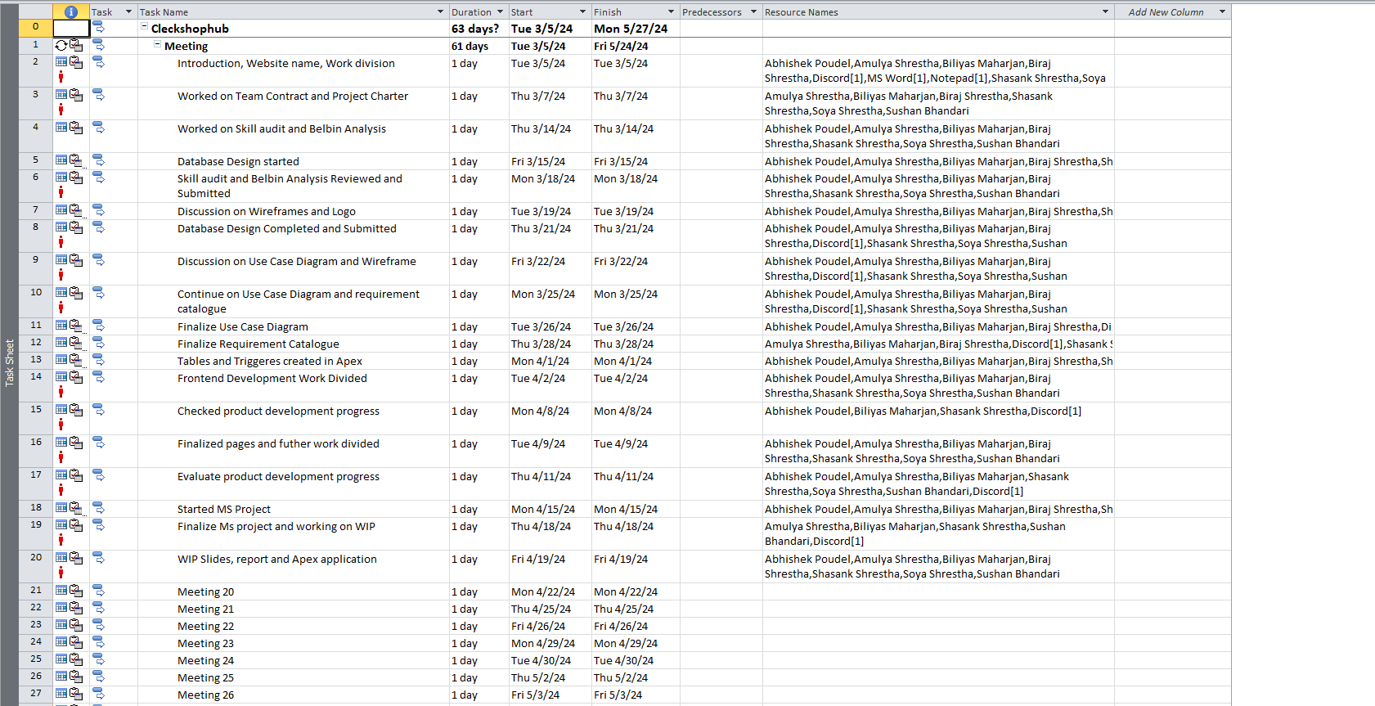
TASK SHEET
12

Slide 13
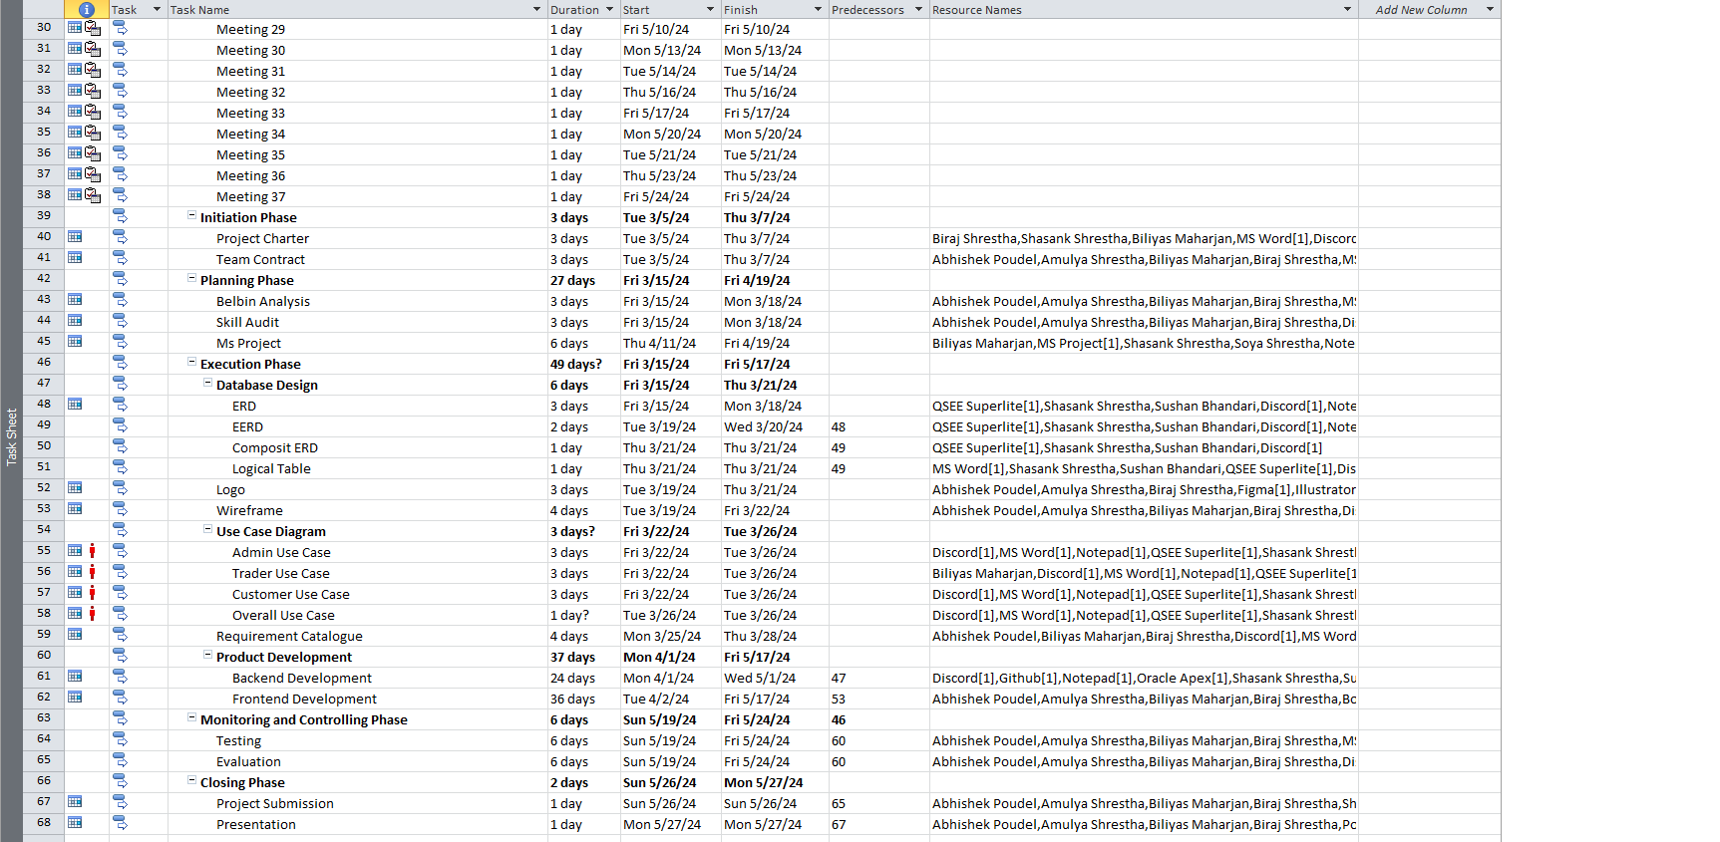
TASK SHEET
13

Slide 14
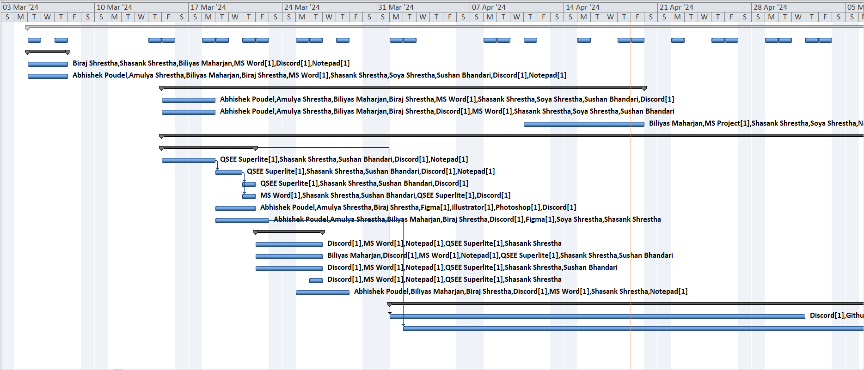
GANTT CHART
14

Slide 15
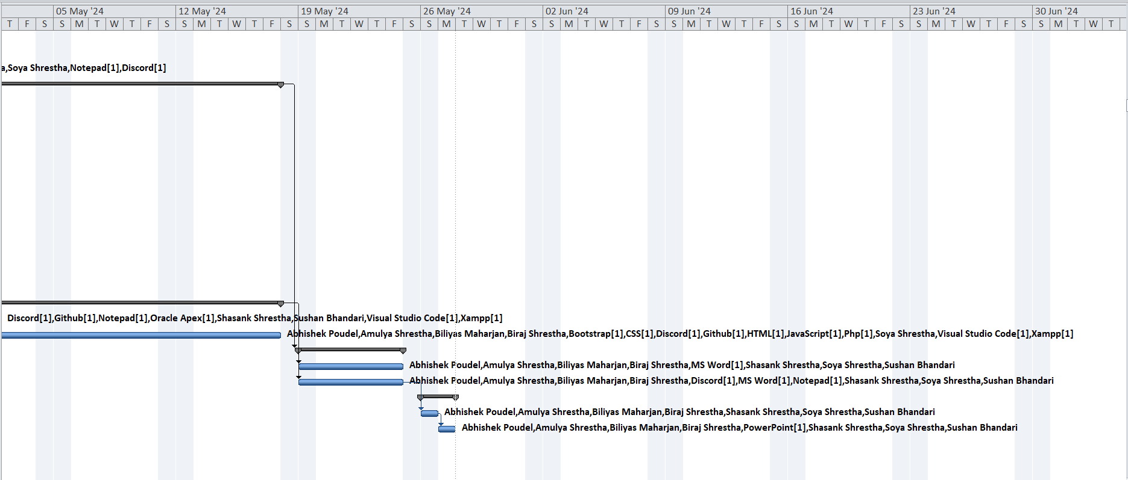
GANTT CHART
15

Slide 16
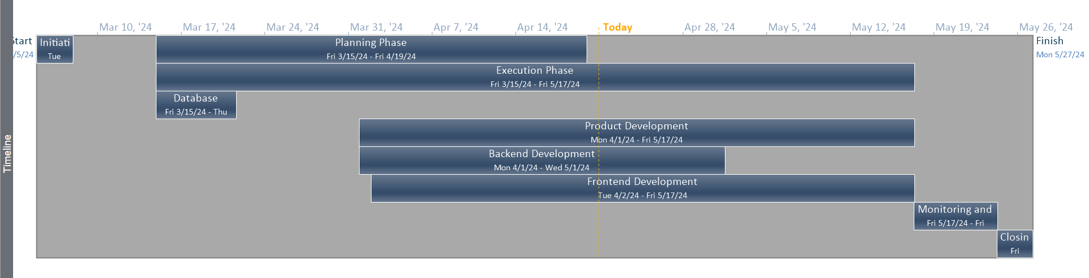
TIMELINE
16

Slide 17
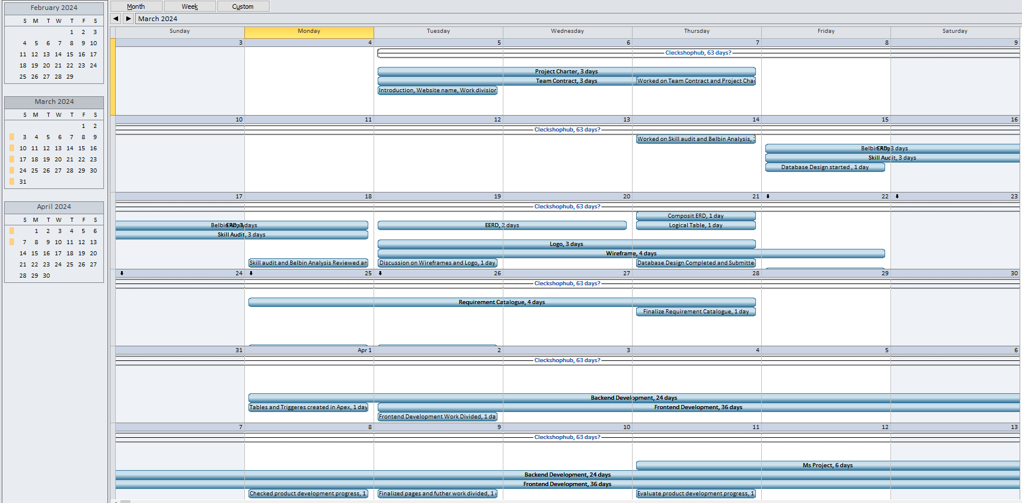
CALENDAR
17

Slide 18
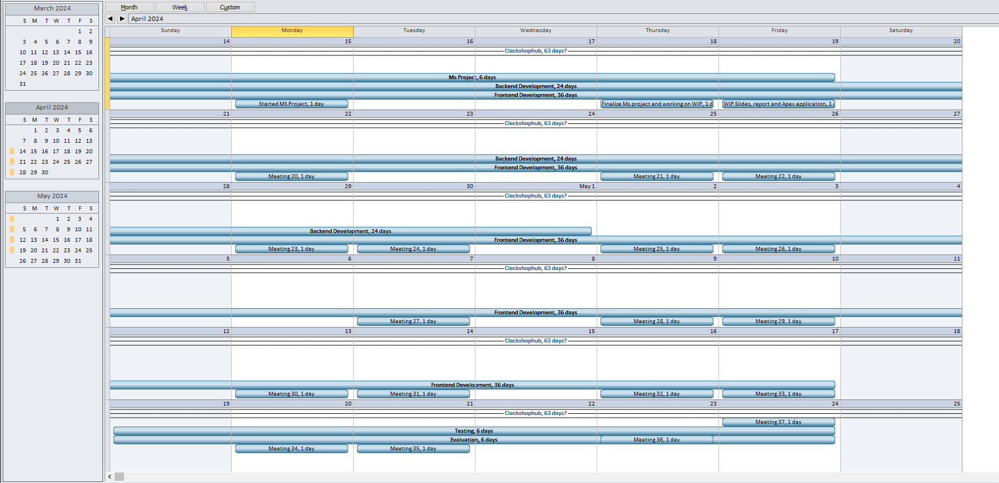
CALENDAR
18

Slide 19
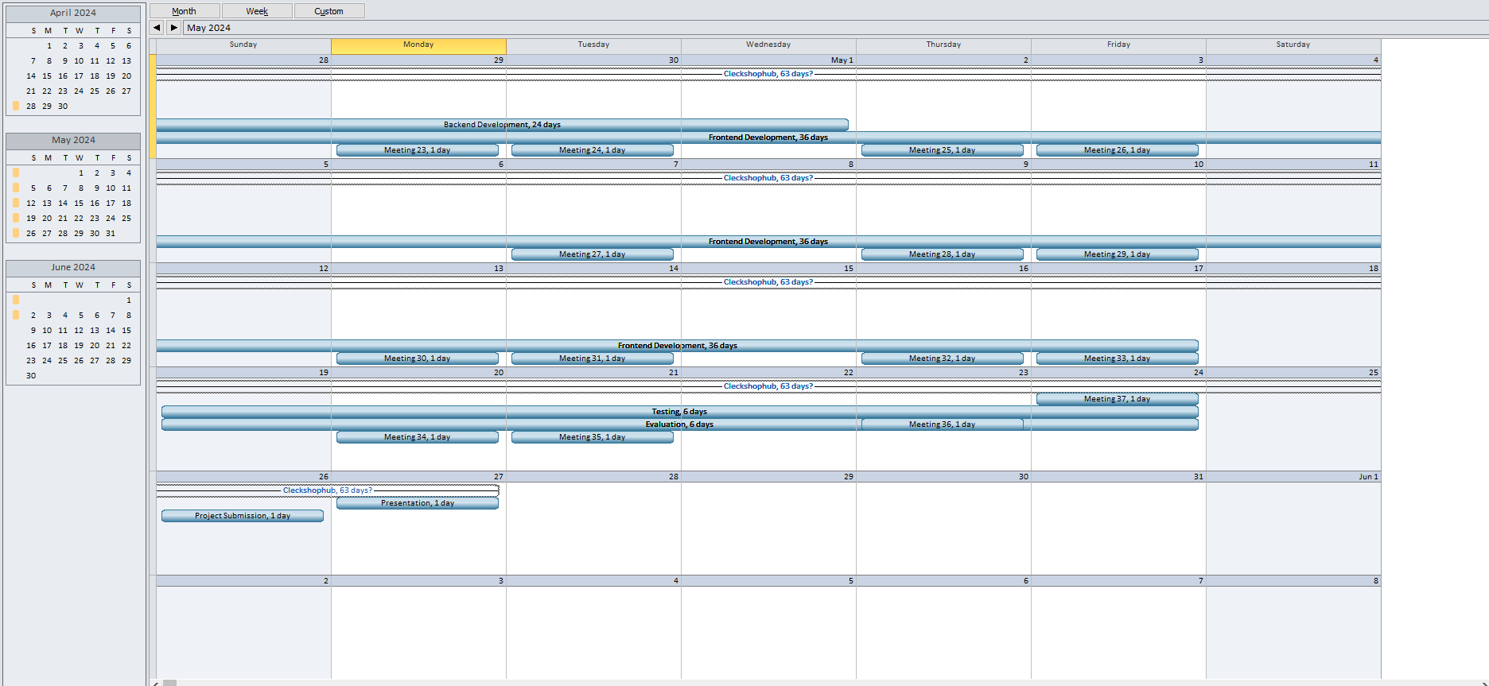
CALENDAR
19

Slide 20
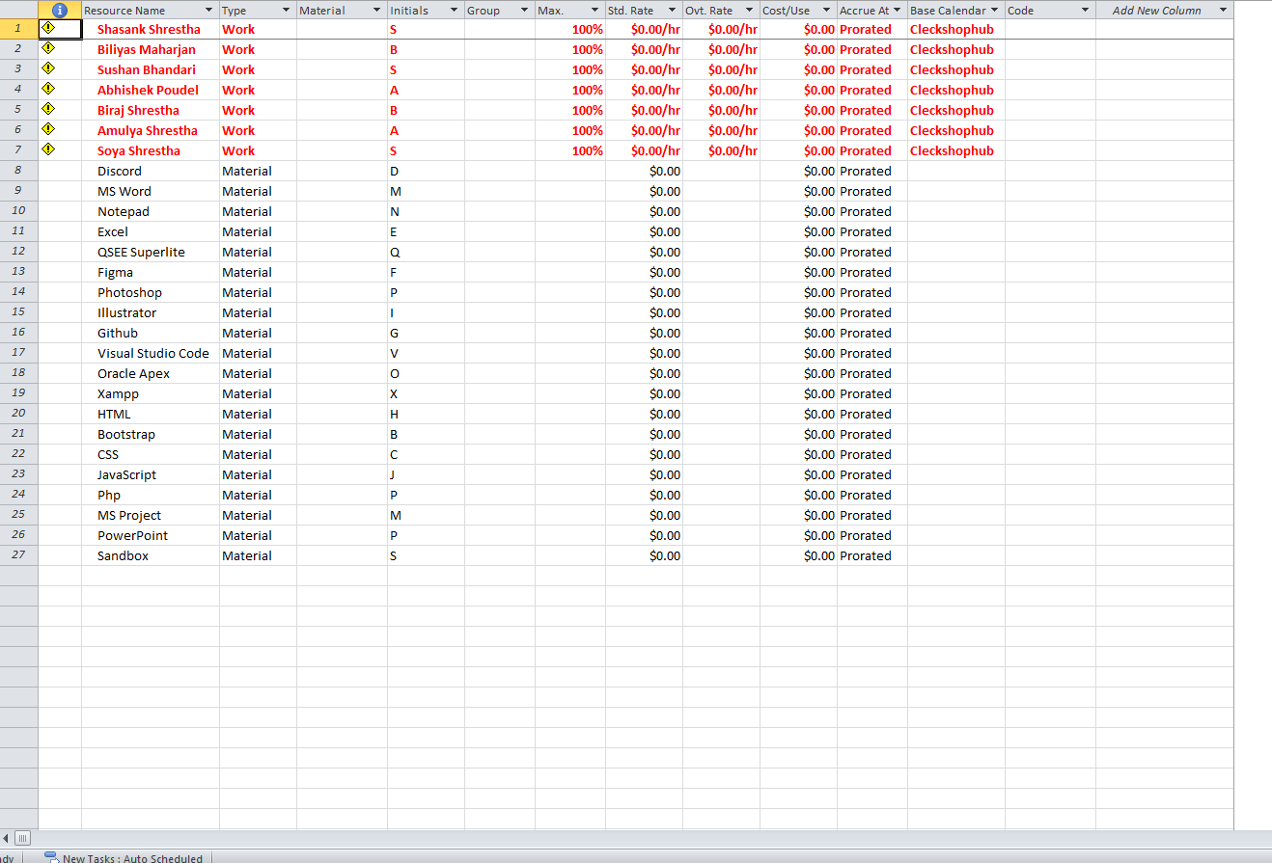
RESOURCE SHEET
20

Slide 21


COMMUNICATION TOOLS
DISCORD
GOOGLE CHAT
21

Slide 22
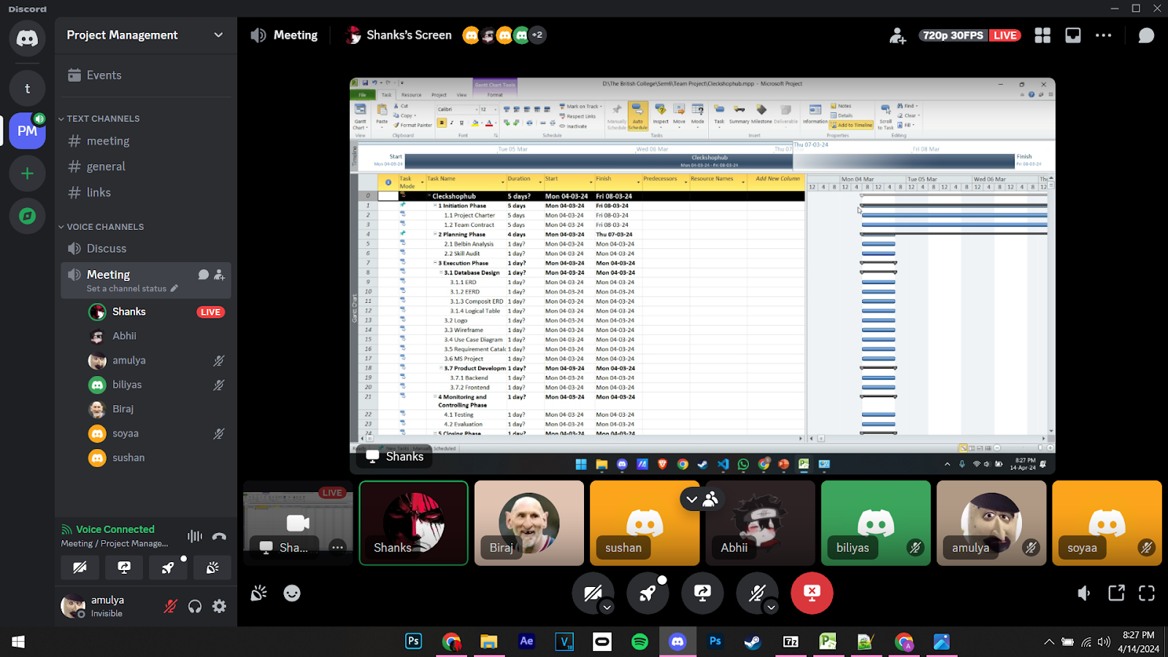
ONLINE MEETING
Platform: DISOCRD

Slide 23
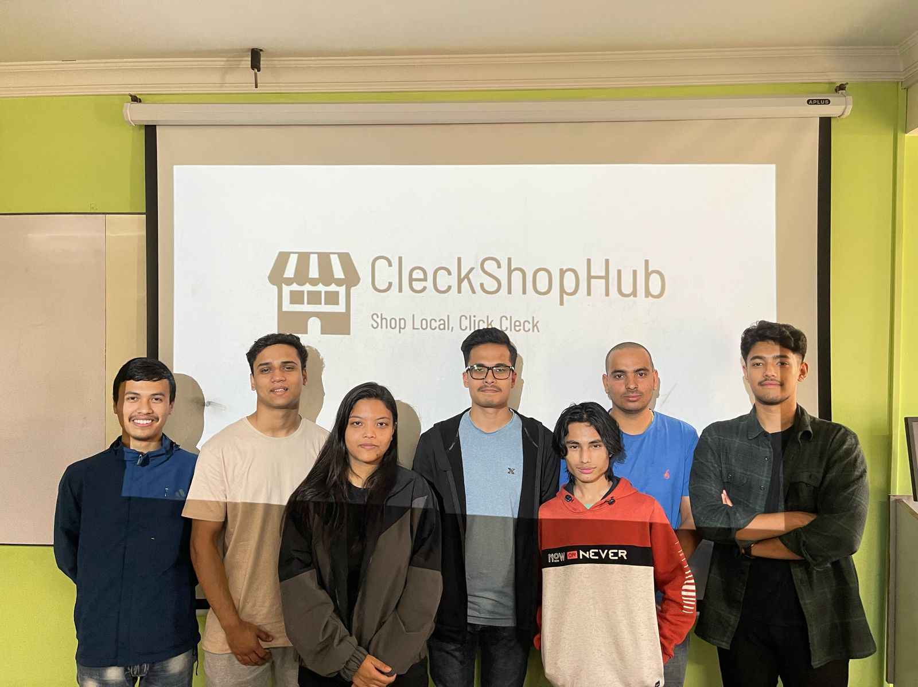
PHYSICAL MEETING

Slide 24
EXECUTION PHASE
Database Design
Use Case Diagram
Logo and Wireframe
Requirement Catalogue
Product Development

Slide 25
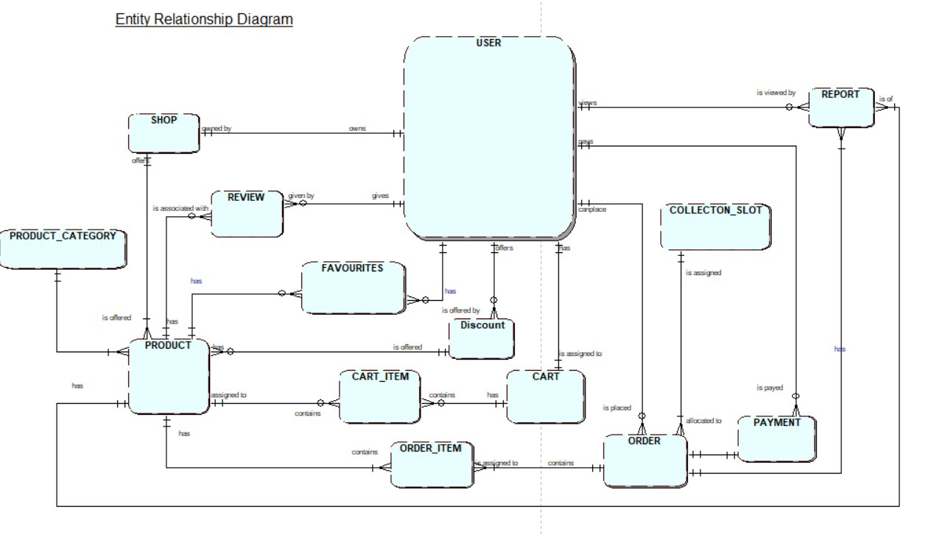
ERD

Slide 26
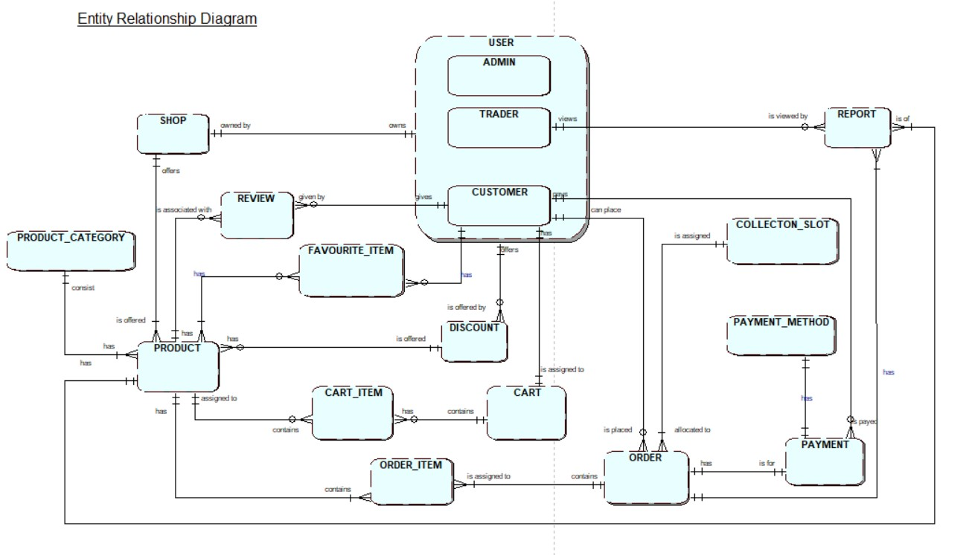
EERD

Slide 27
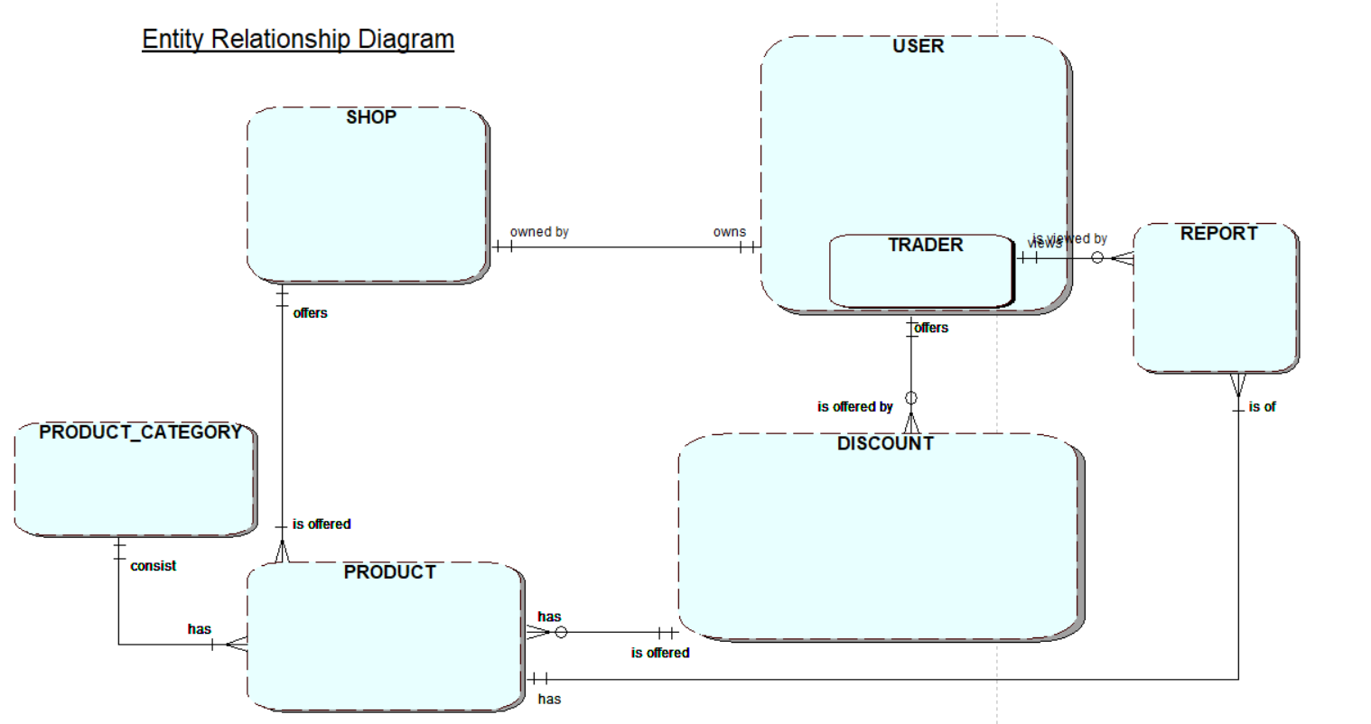
TRADER RELATION

Slide 28
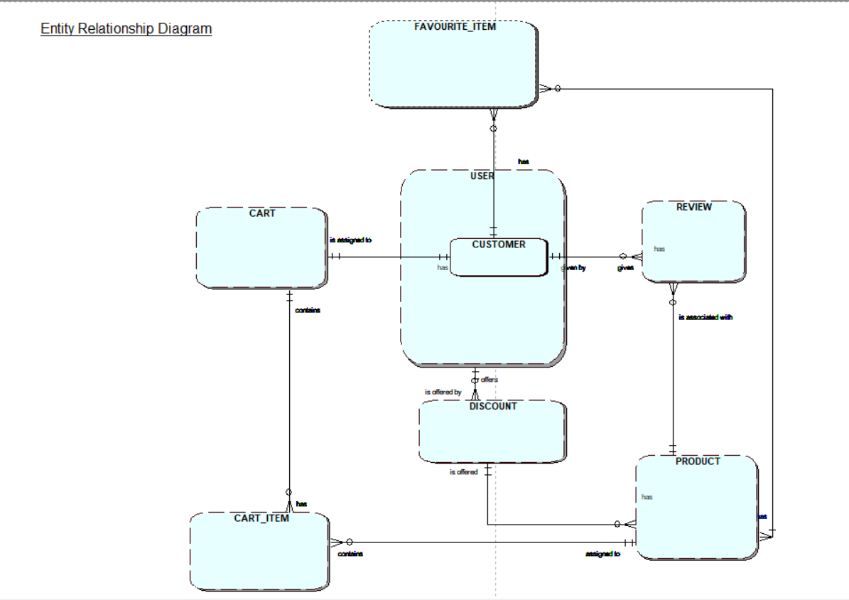
CUSTOMER RELATION

Slide 29
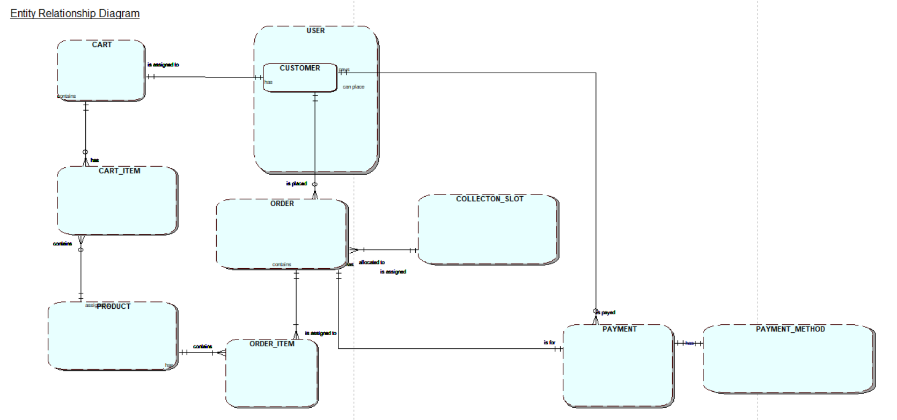
CUSTOMER RELATION

Slide 30
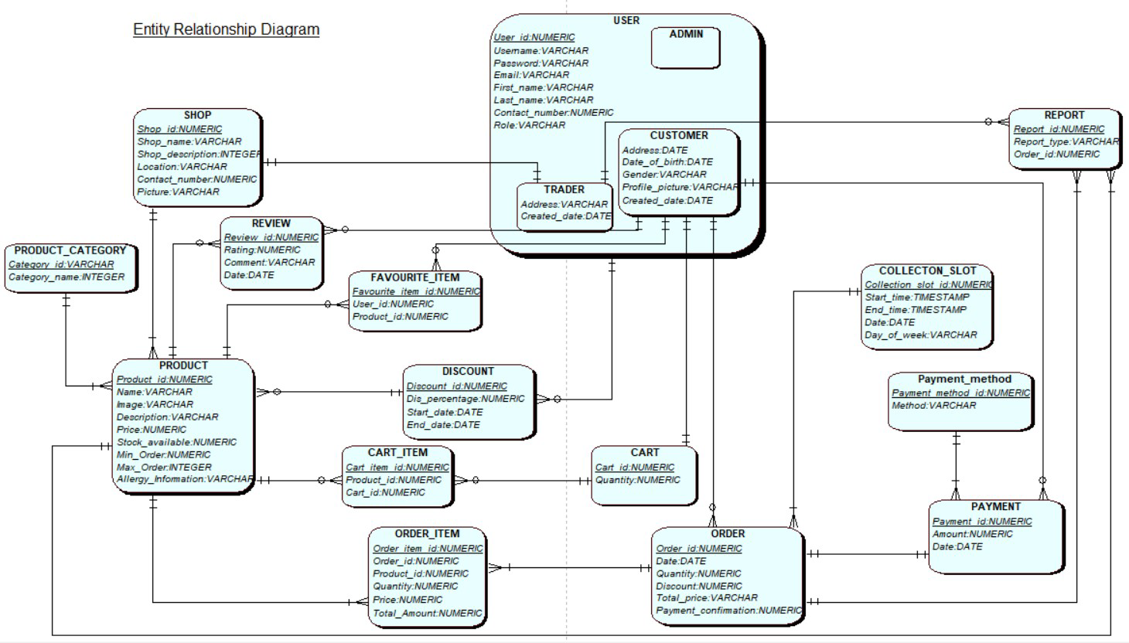
COMPOSITE ERD

Slide 31
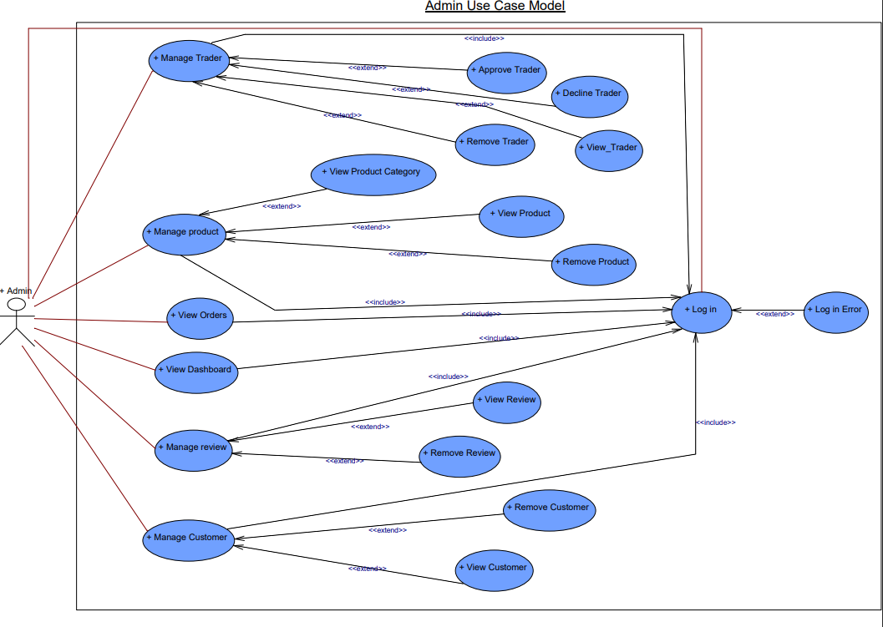
ADMIN USE CASE DIAGRAM

Slide 32
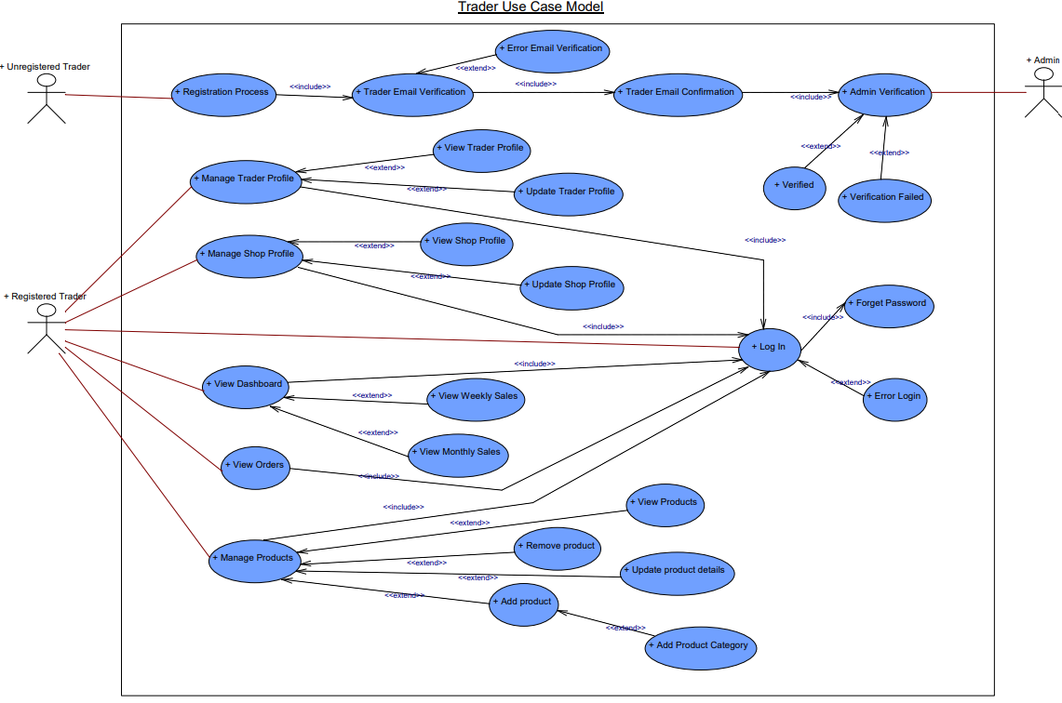
TRADER USE CASE DIAGRAM

Slide 33
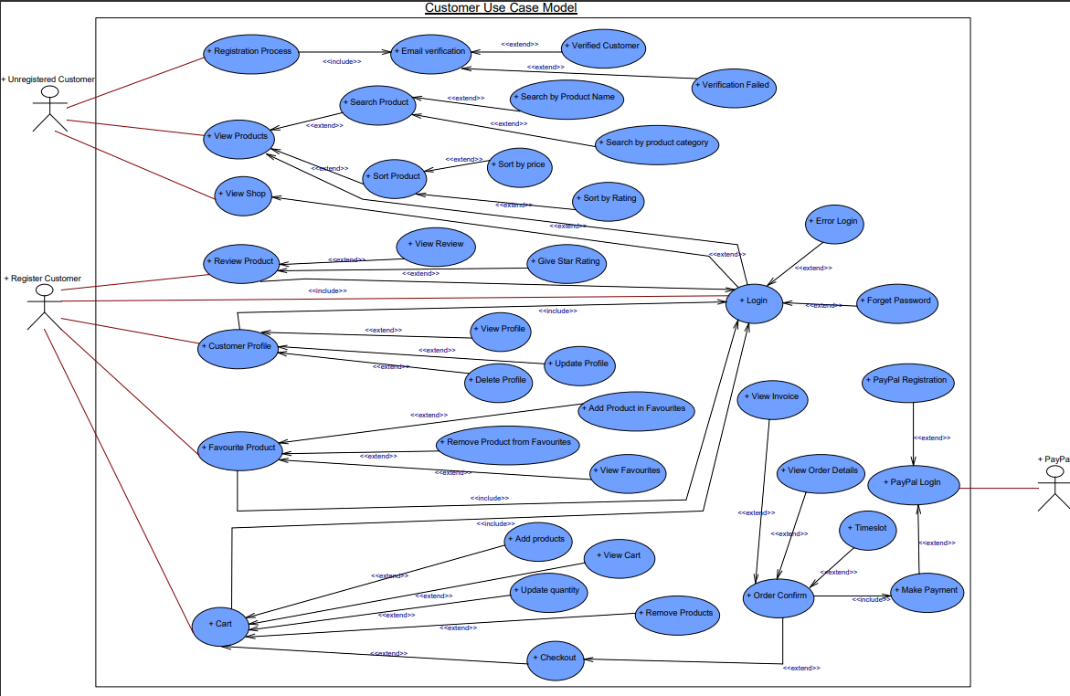
CUSTOMER USE CASE DIAGRAM

Slide 34

LOGO
CLECKSHOPHUB
34

Slide 35

WIREFRAME
CLECKSHOPHUB
35

Slide 36
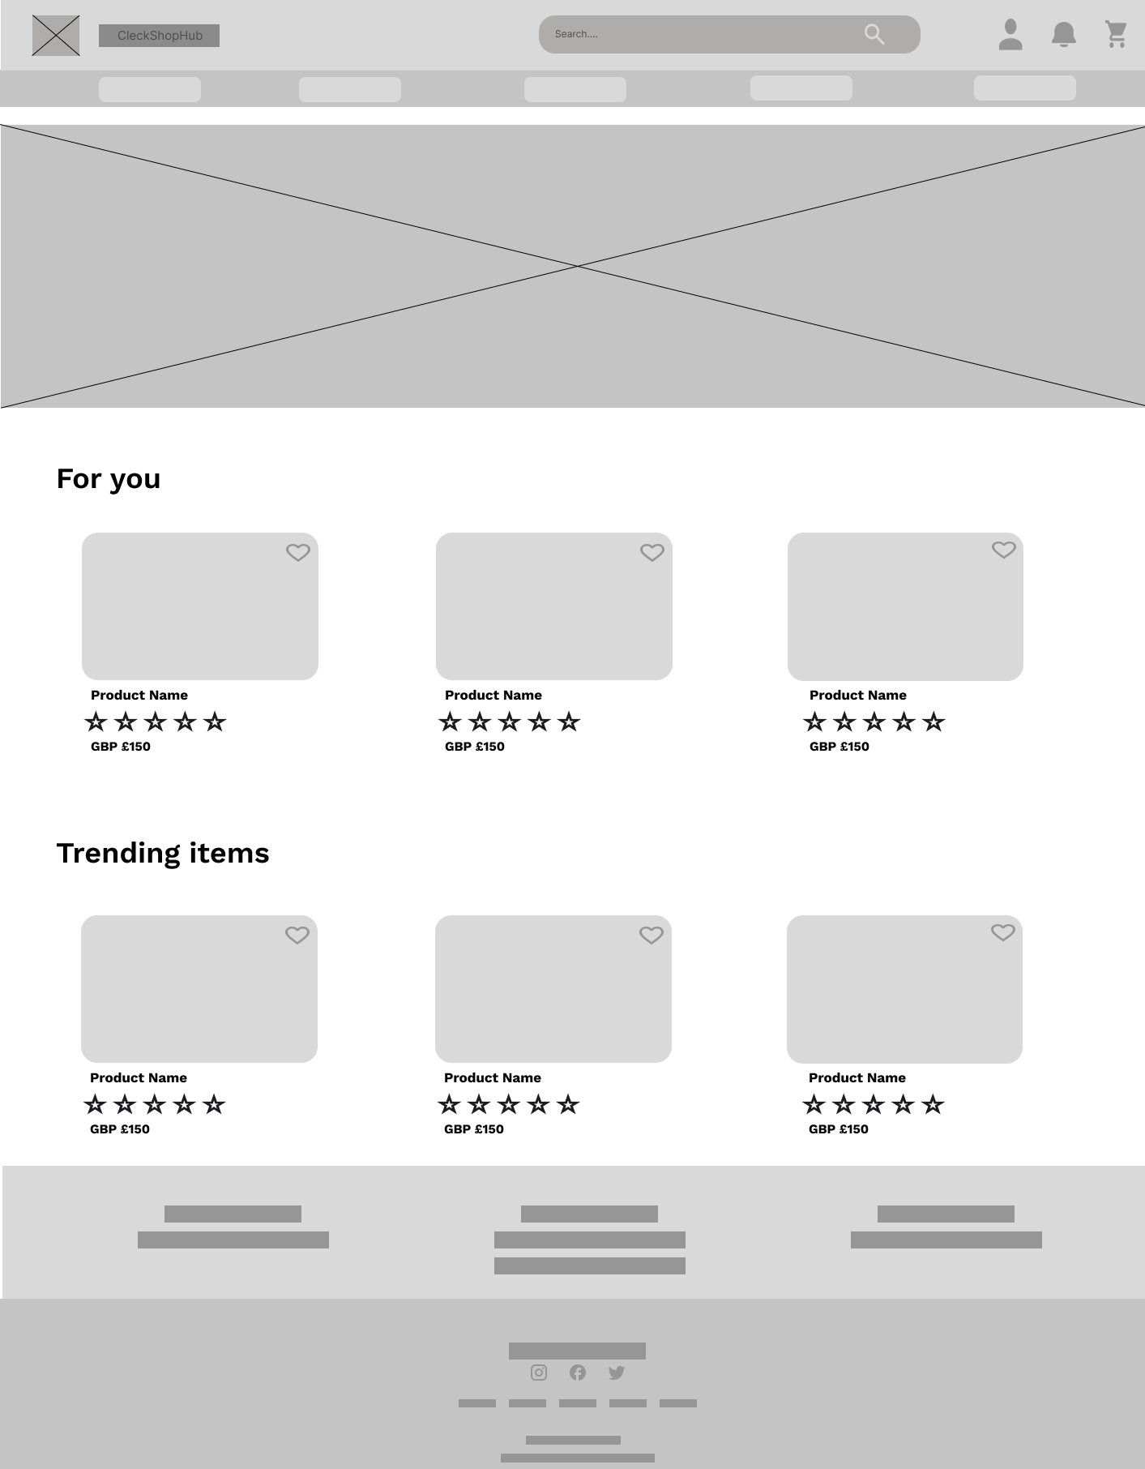
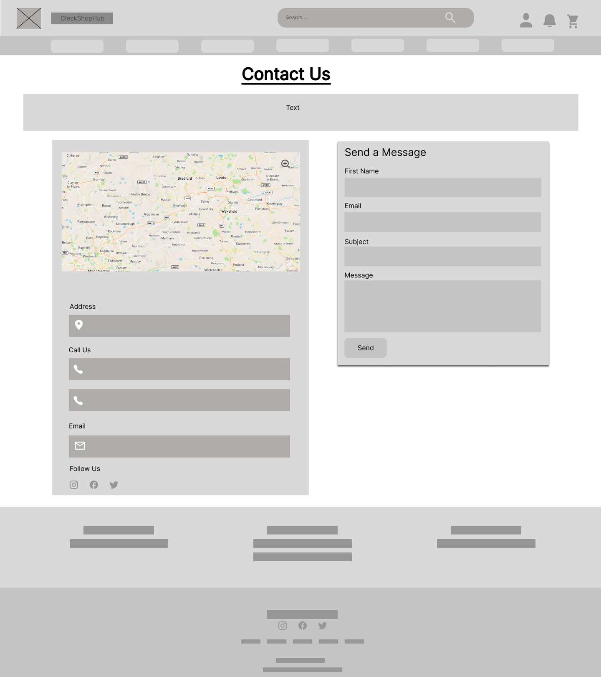
HOME PAGE
CONTACT US

Slide 37
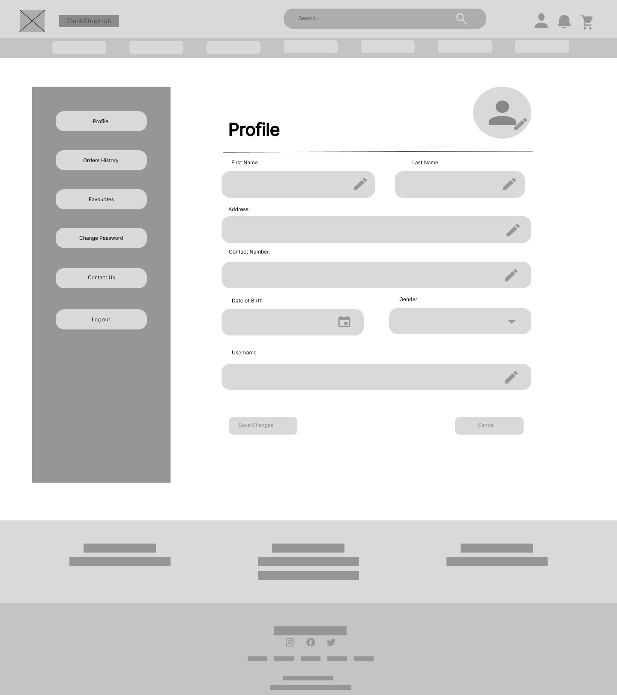
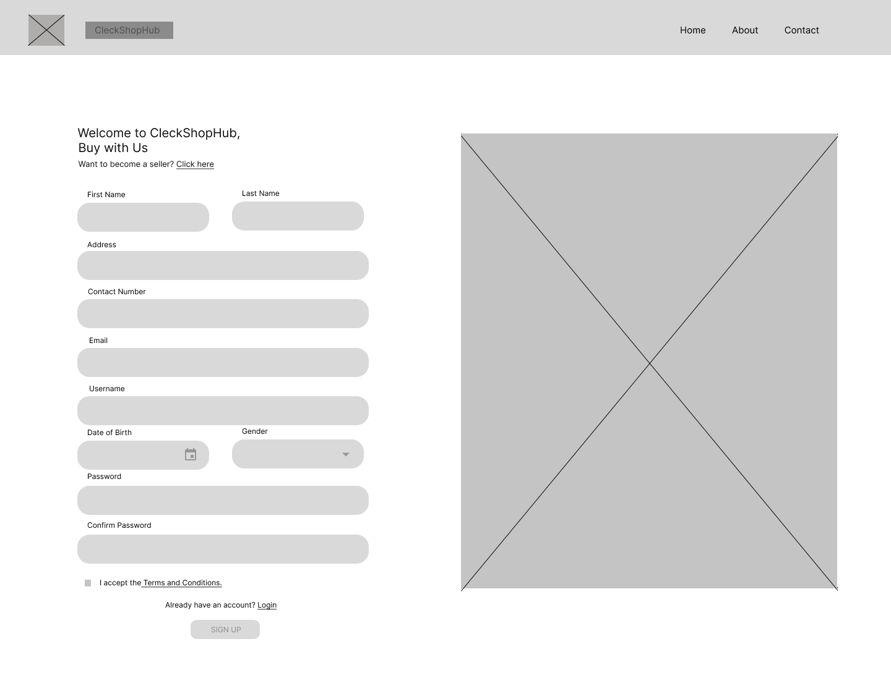
CUSTOMER PROFILE
CUSTOMER SIGN UP

Slide 38
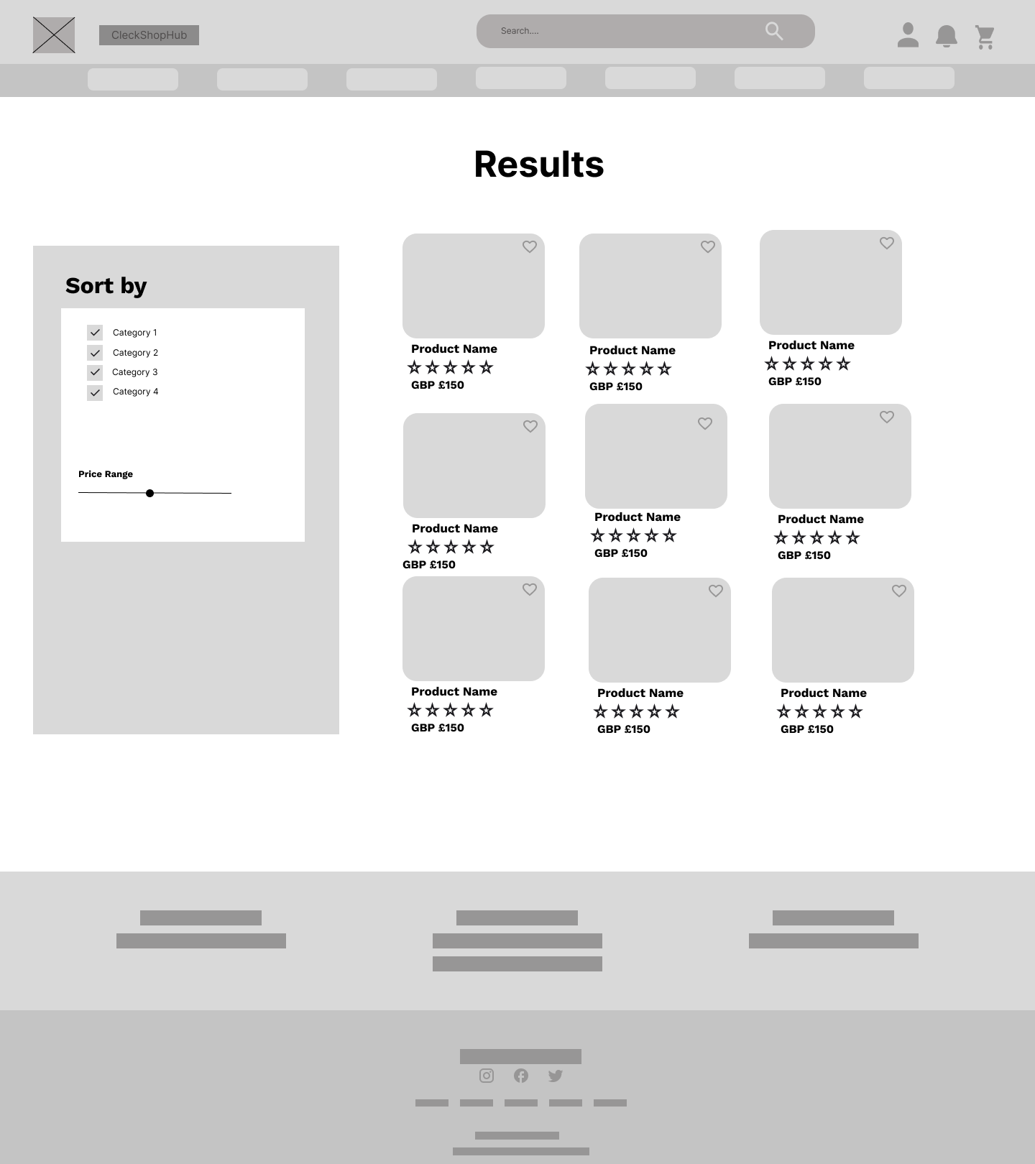
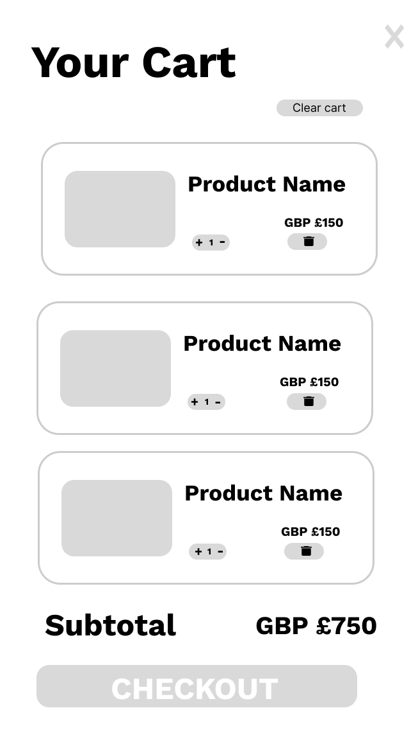
SEARCH PAGE
CART

Slide 39
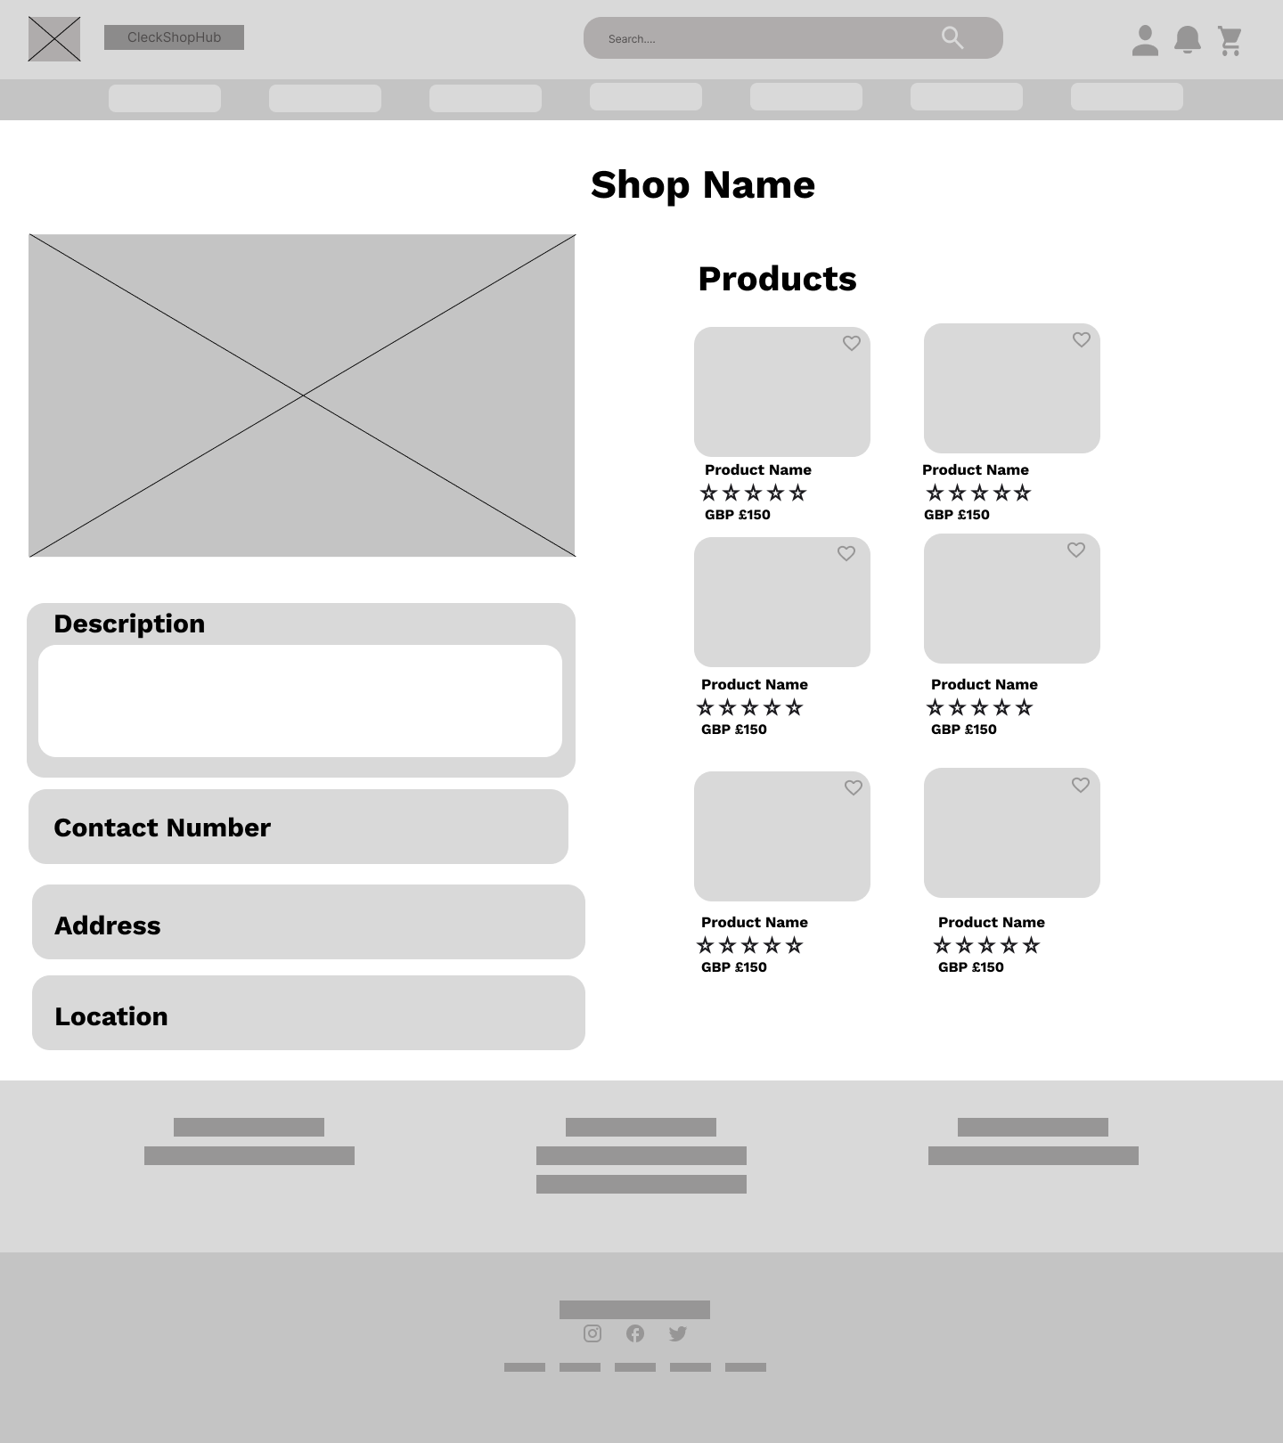
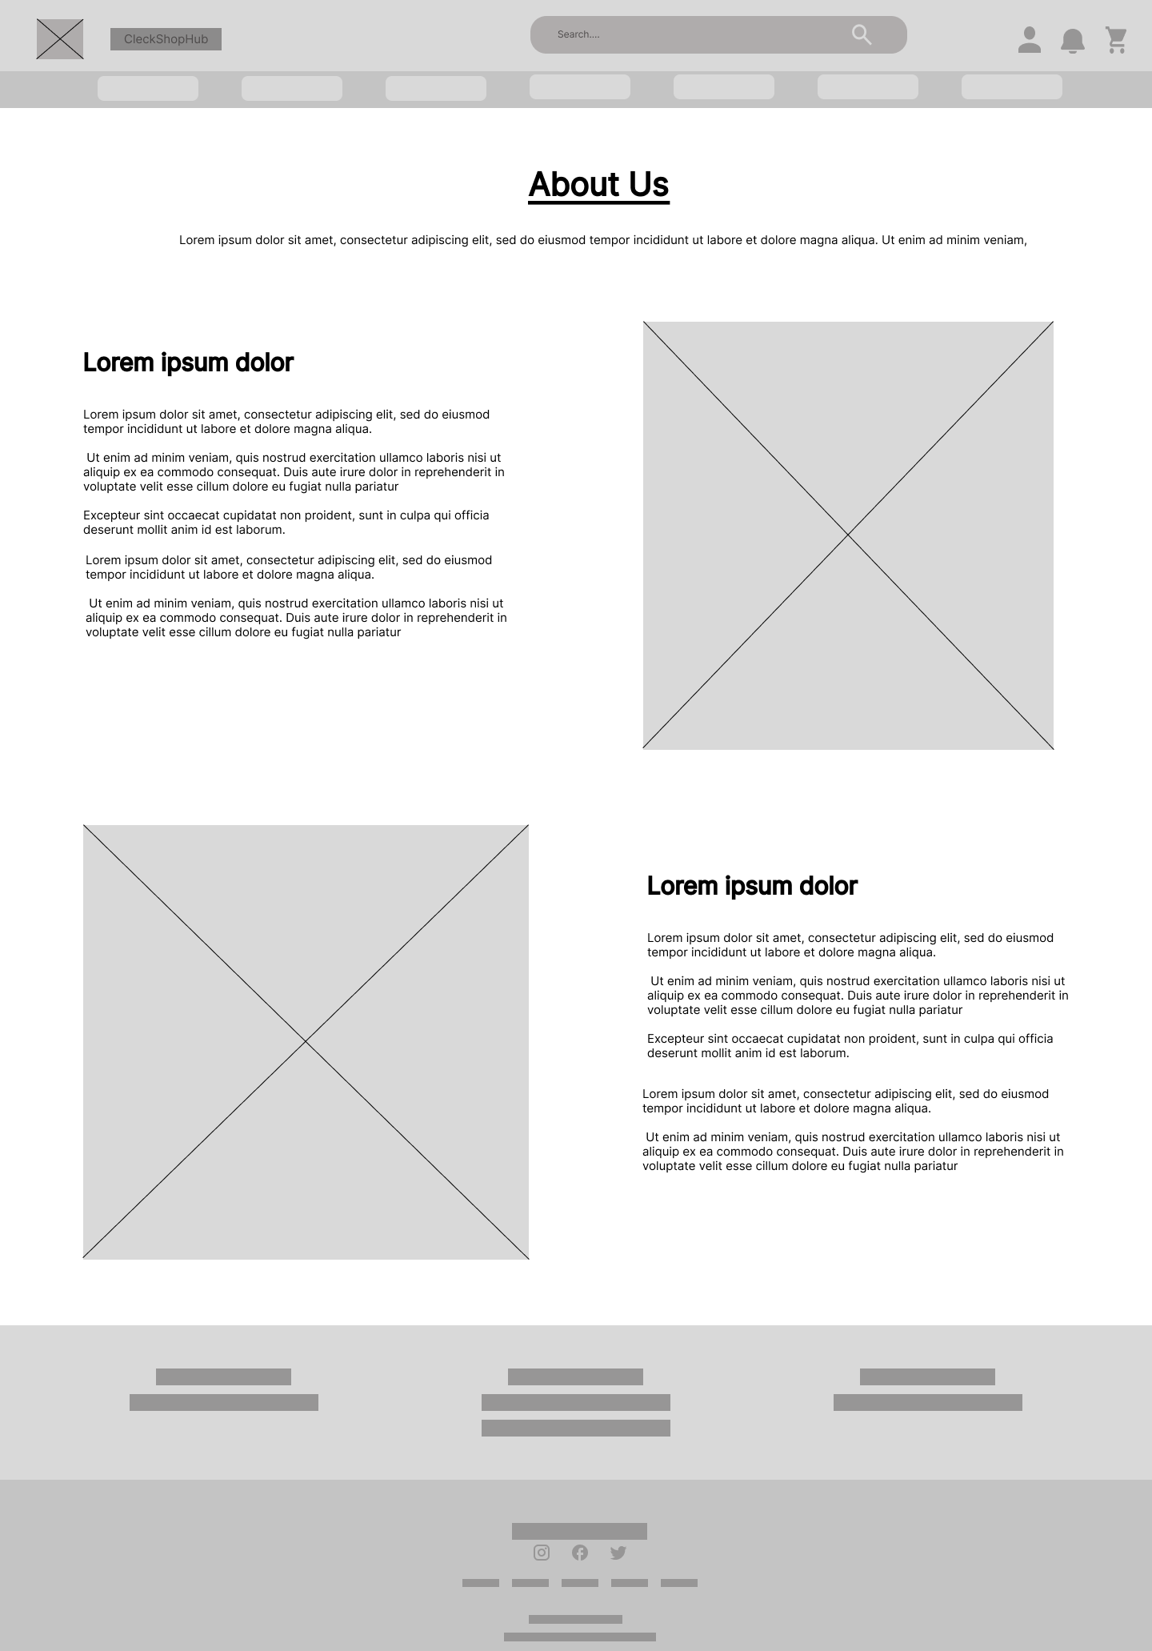
SHOP PAGE
ABOUT US

Slide 40
REQUIREMENTS
Product
All product need details
An interface to navigate product and shop
An interface to add products in cart and wish list
An interface for review and rating for product

Slide 41
REQUIREMENTS
Customer
An interface to register for new user
Customer has access to cart
An interface for user login
Customer has wishlist
An interface to view and update profile
An interface to place order
Customer should be able to view product
An interface to review product
An interface to view order details

Slide 42
REQUIREMENTS
Trader
An interface for trader registration and login
An interface to view and update profile
Trader can manage product and shop
Access to dashboard and reports

Slide 43
REQUIREMENTS
Admin
An Apex login interface
Manage trader and user
Manage reports
Payment

Slide 44





PRODUCT DEVELOPMENT
FRONT END
HTML
CSS
PHP
JAVA SCRIPT
BOOTSTRAP

Slide 45
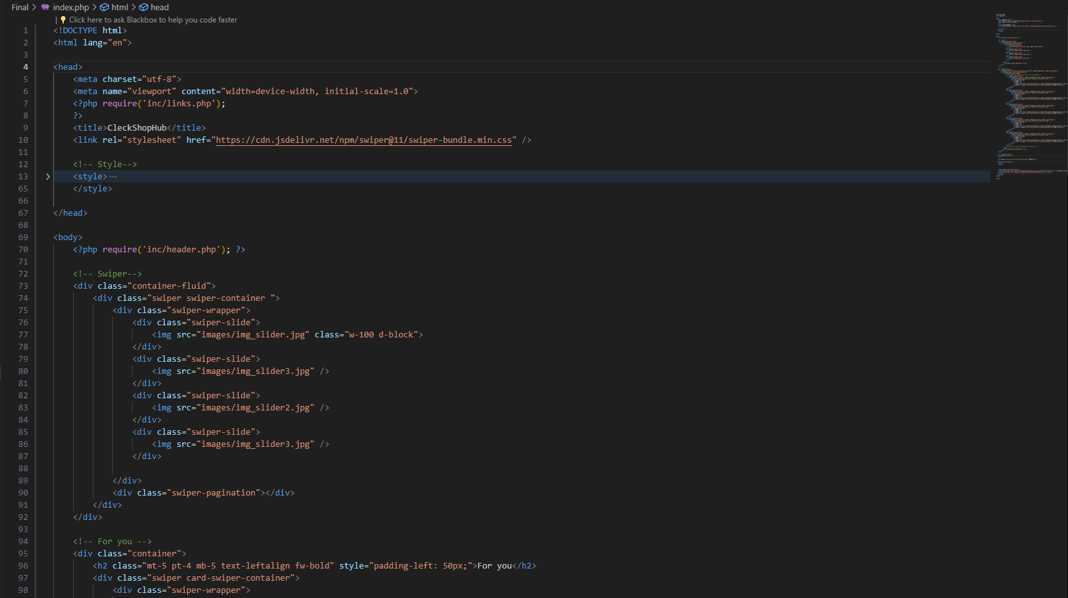
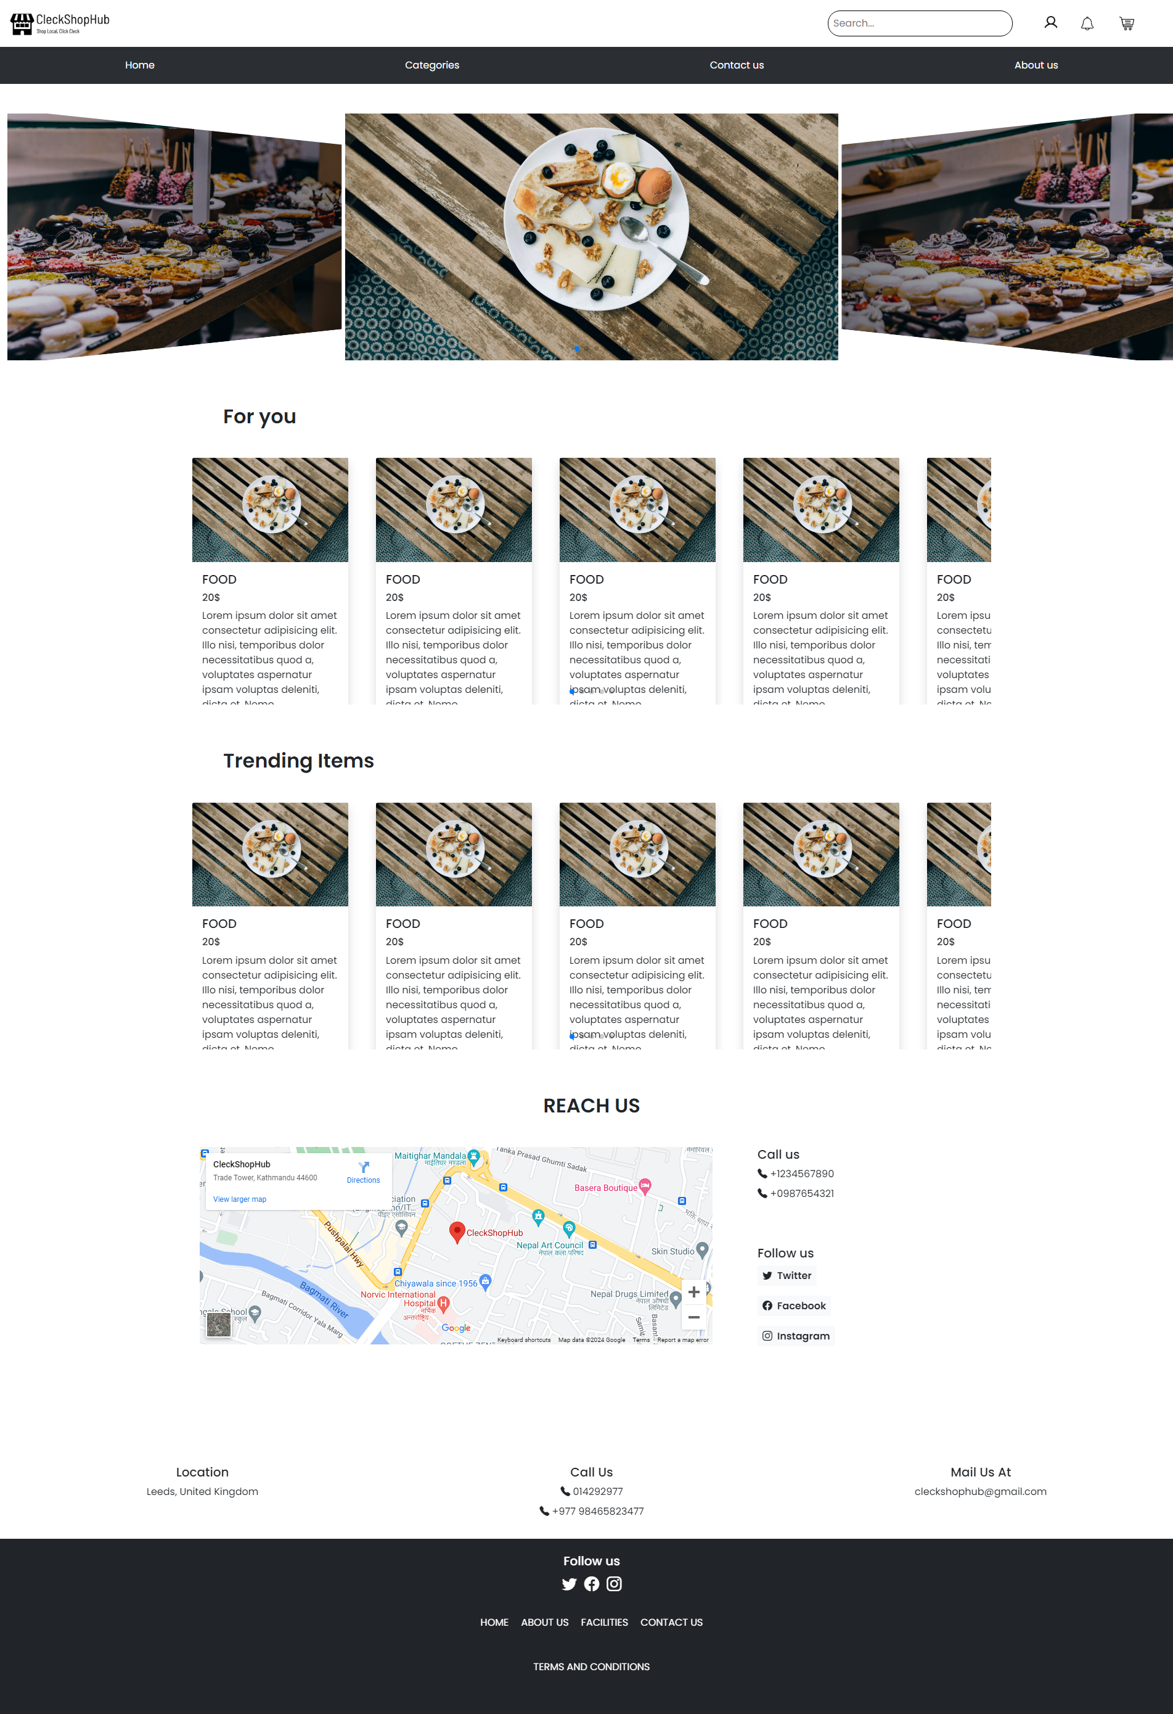
HOME PAGE

Slide 46
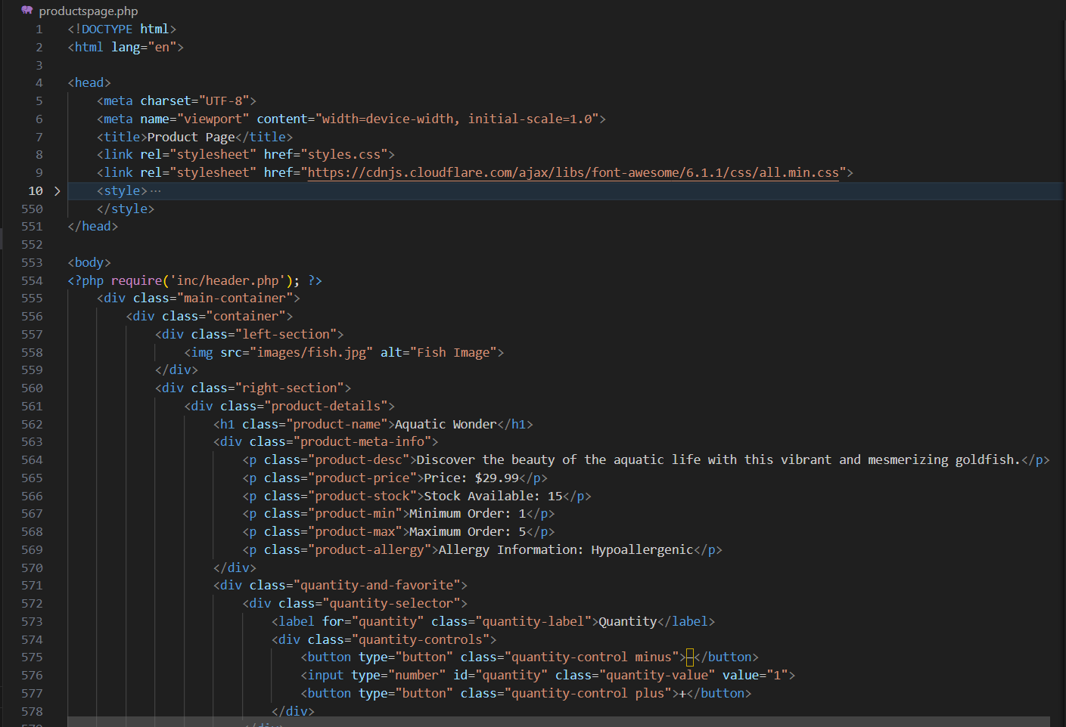
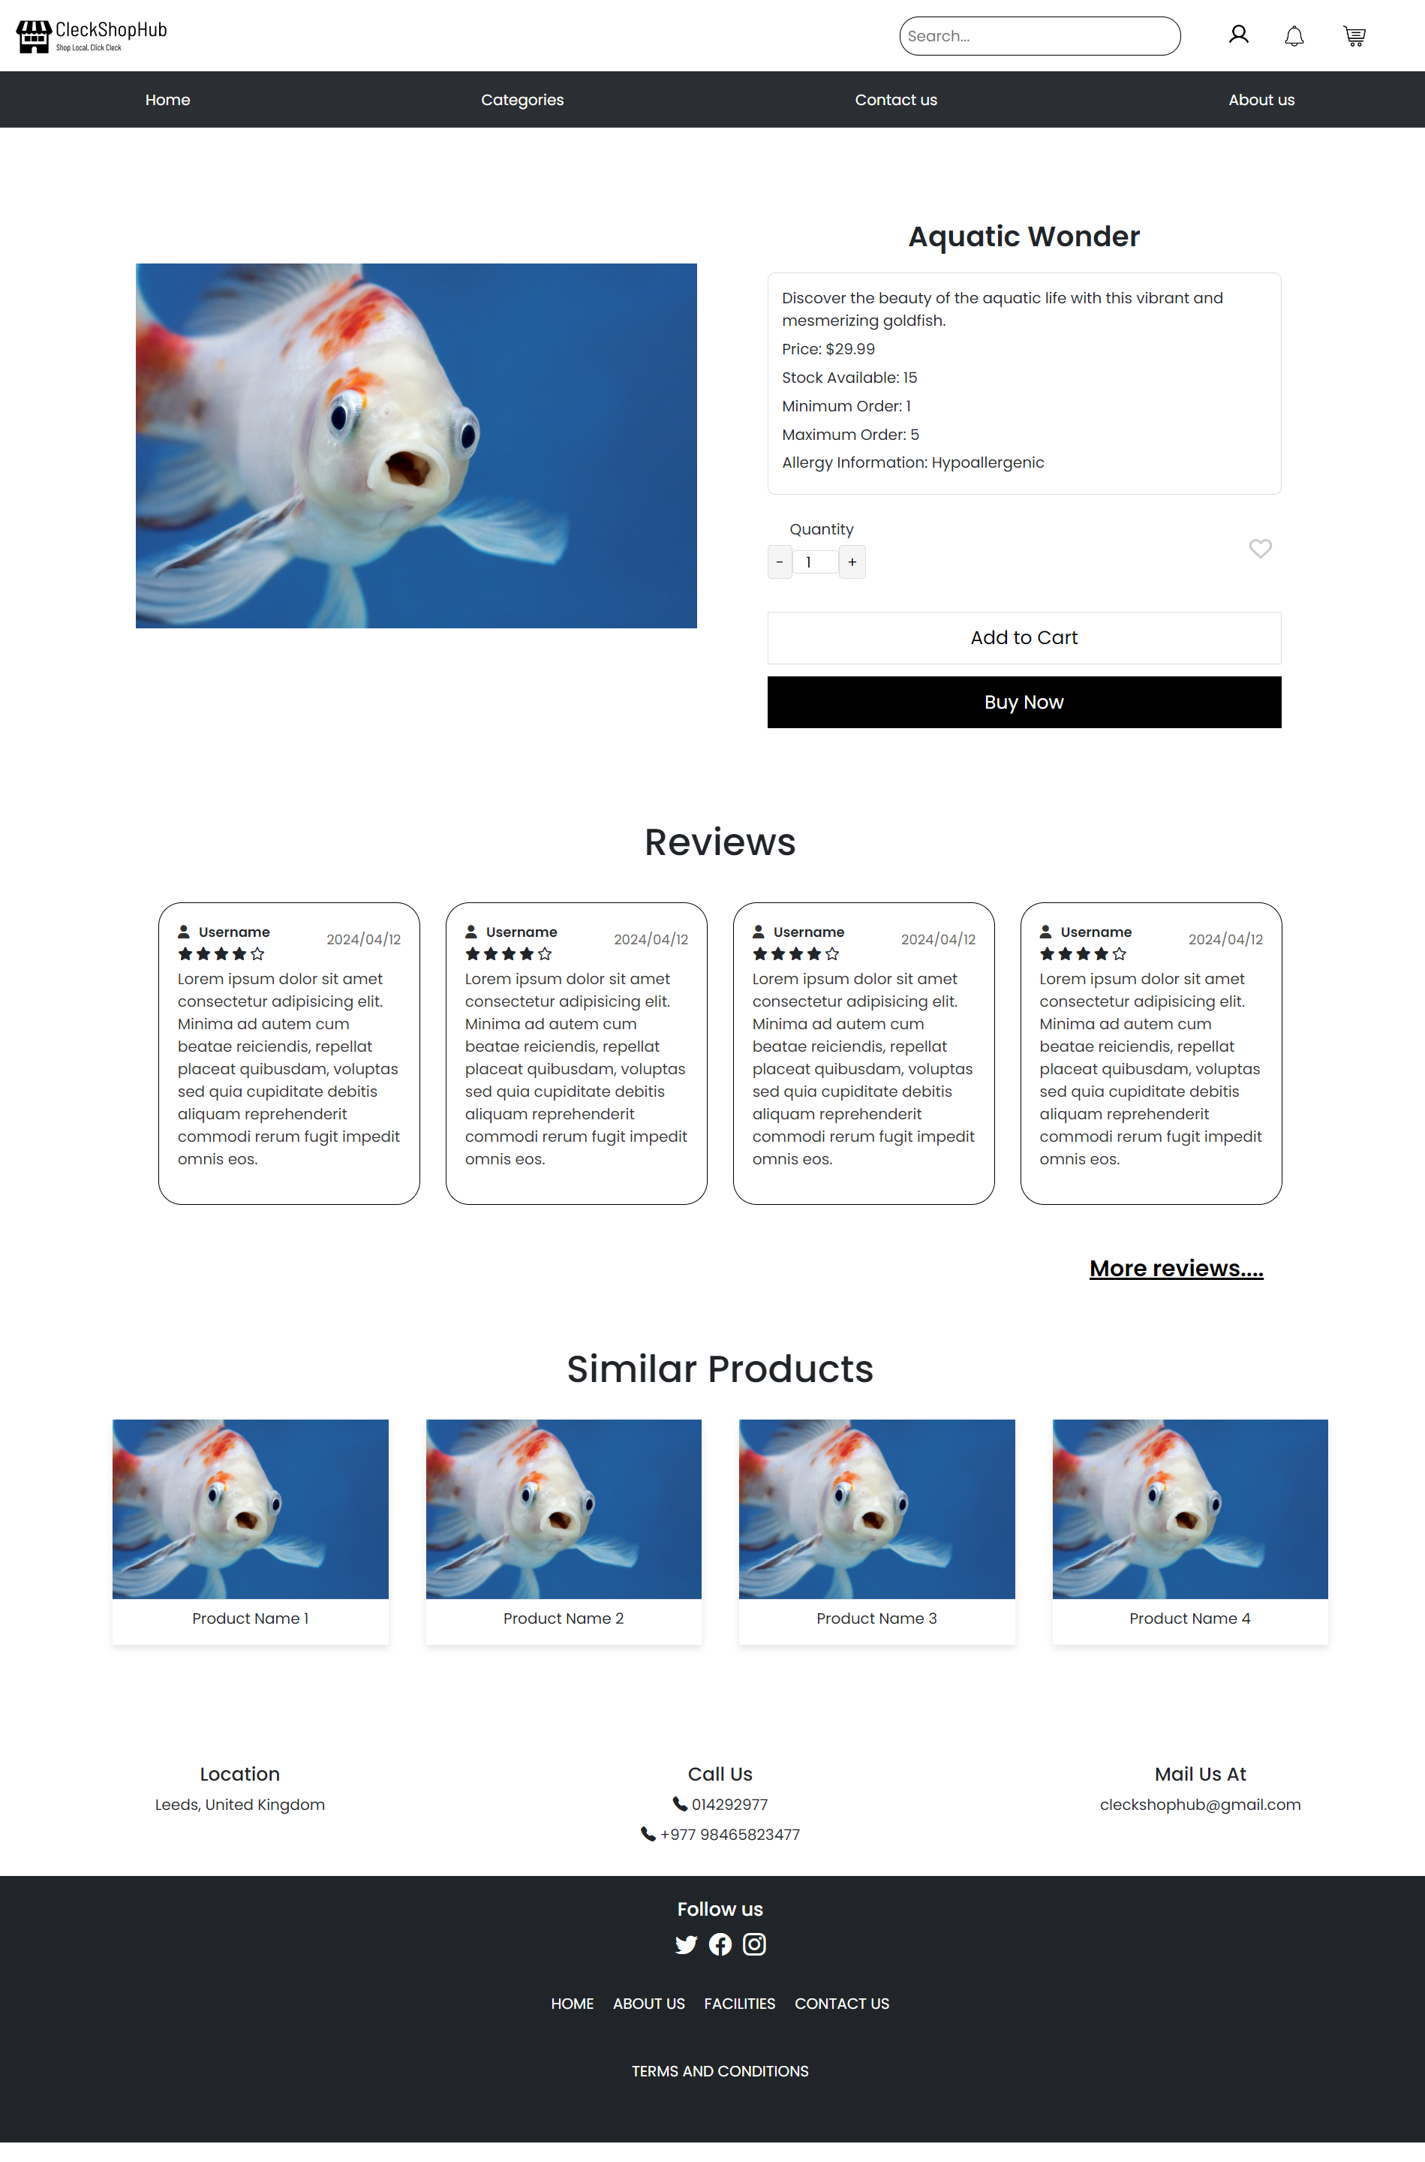
PRODUCT PAGE

Slide 47
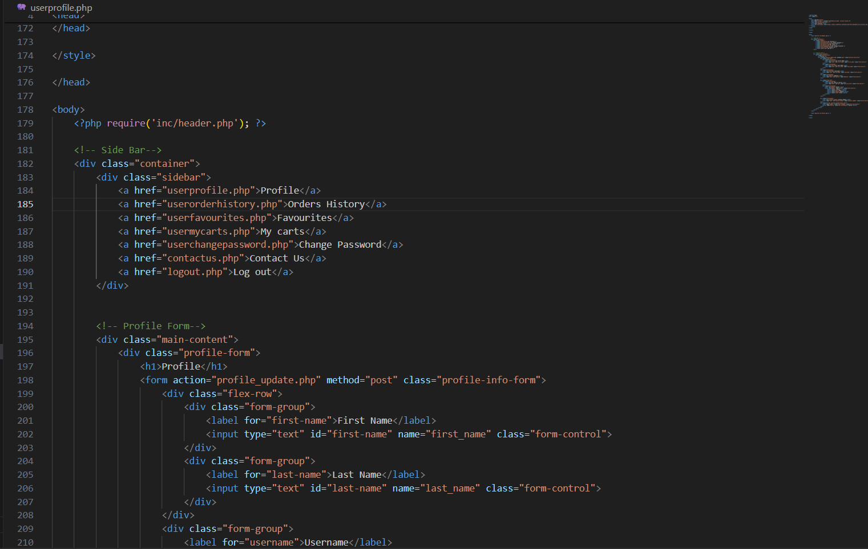
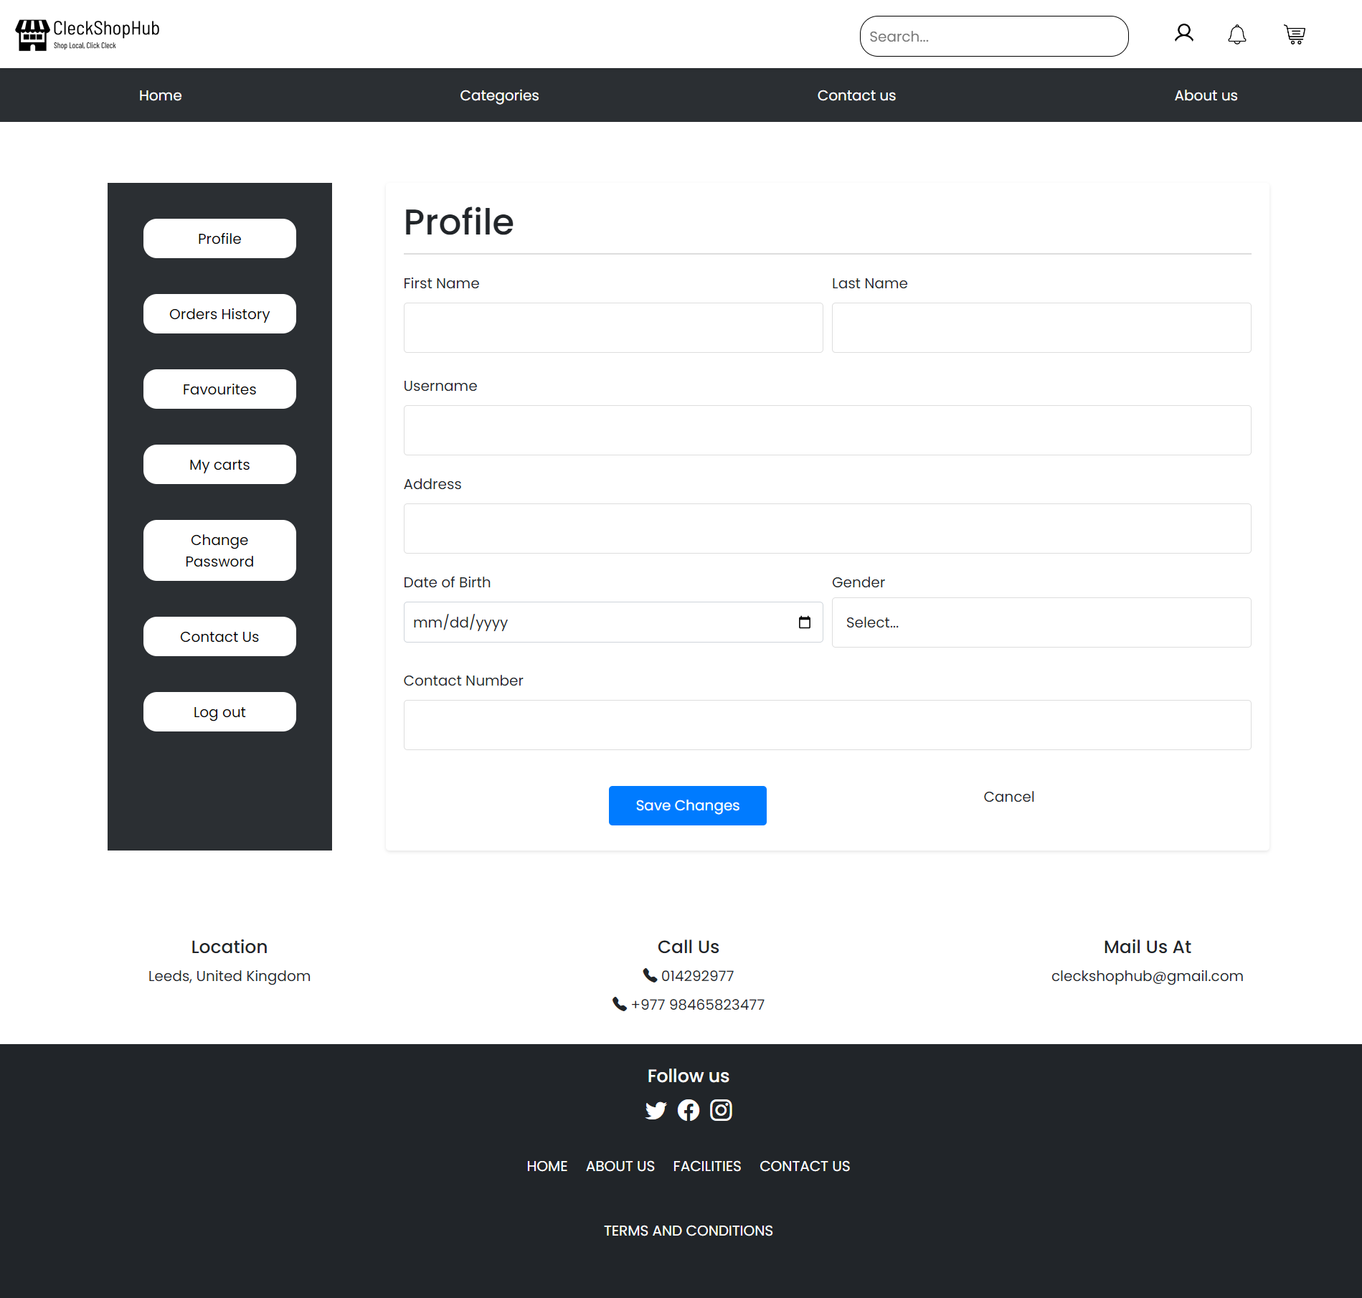
USER PROFILE PAGE

Slide 48
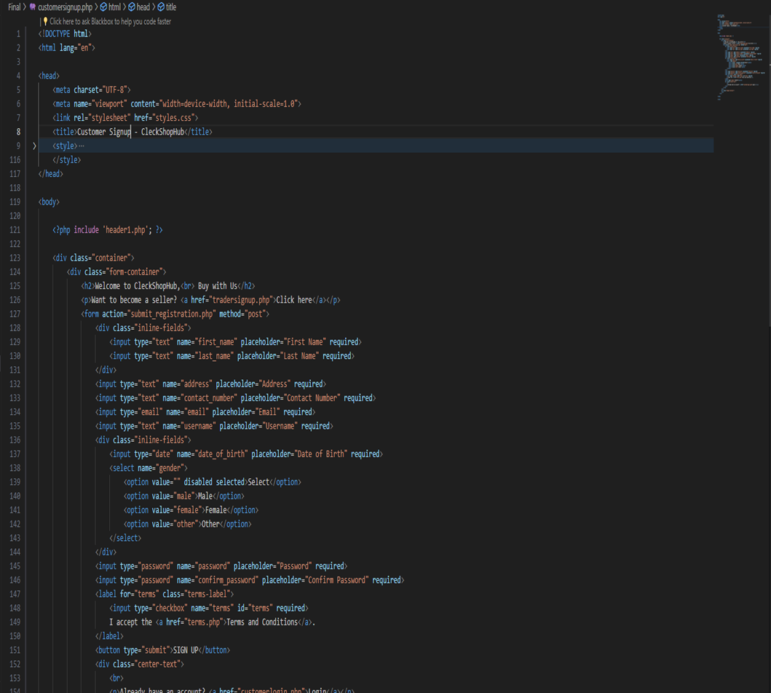
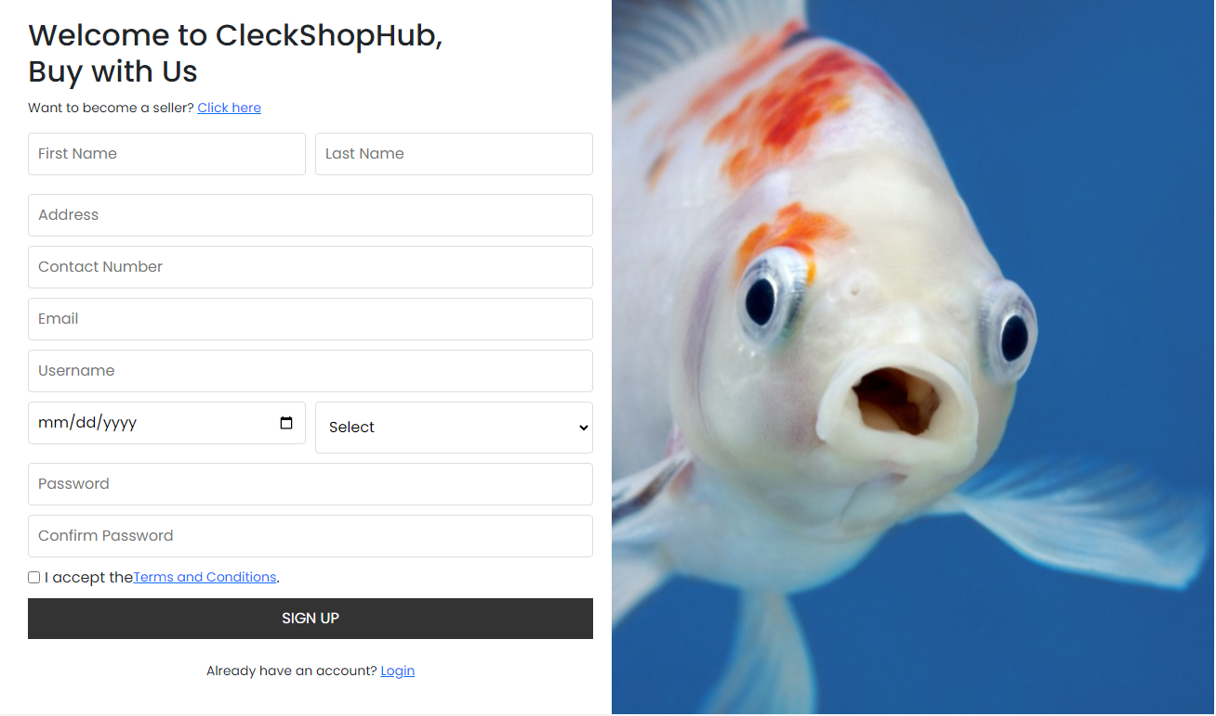
CUSTOMER REGISTRATION PAGE

Slide 49


PRODUCT DEVELOPMENT BACK END
ORACLE APEX
SQL DATABASE

Slide 50
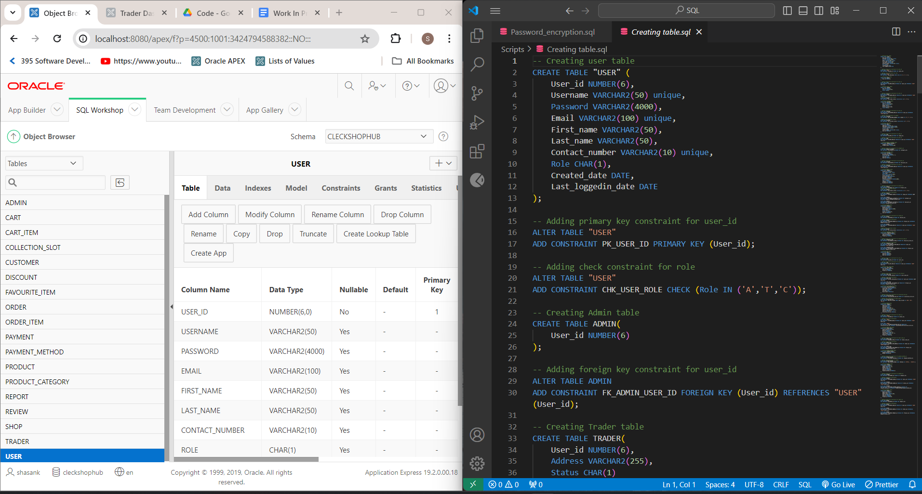
TABLES CREATED

Slide 51
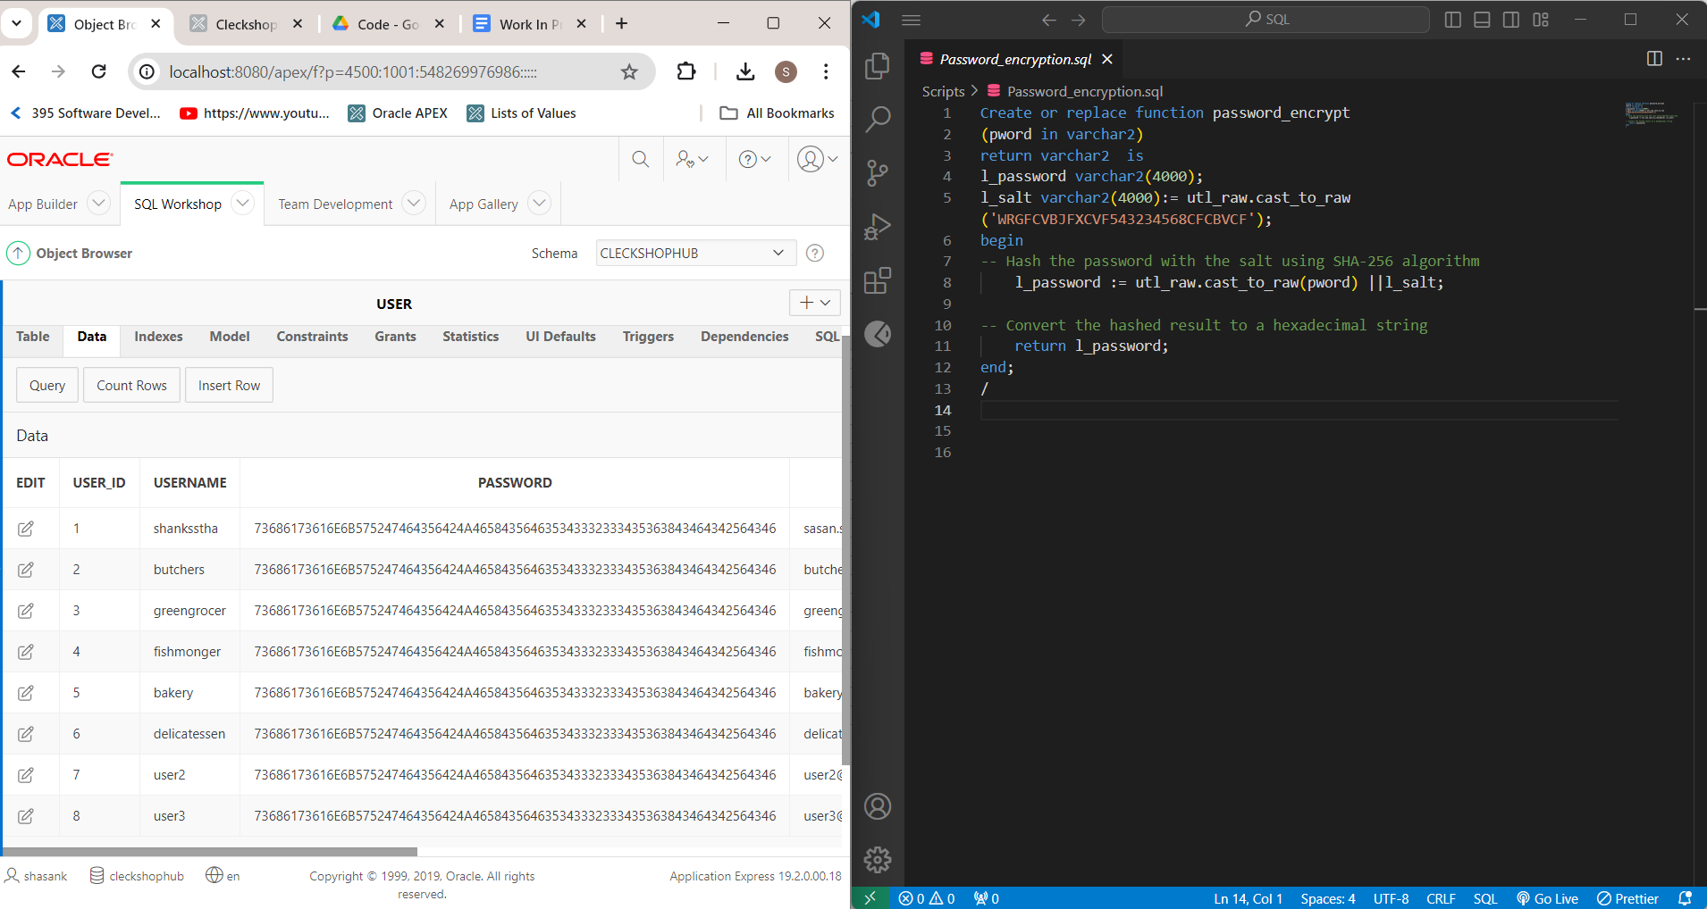
PASSWORD ENCRYPTION

Slide 52
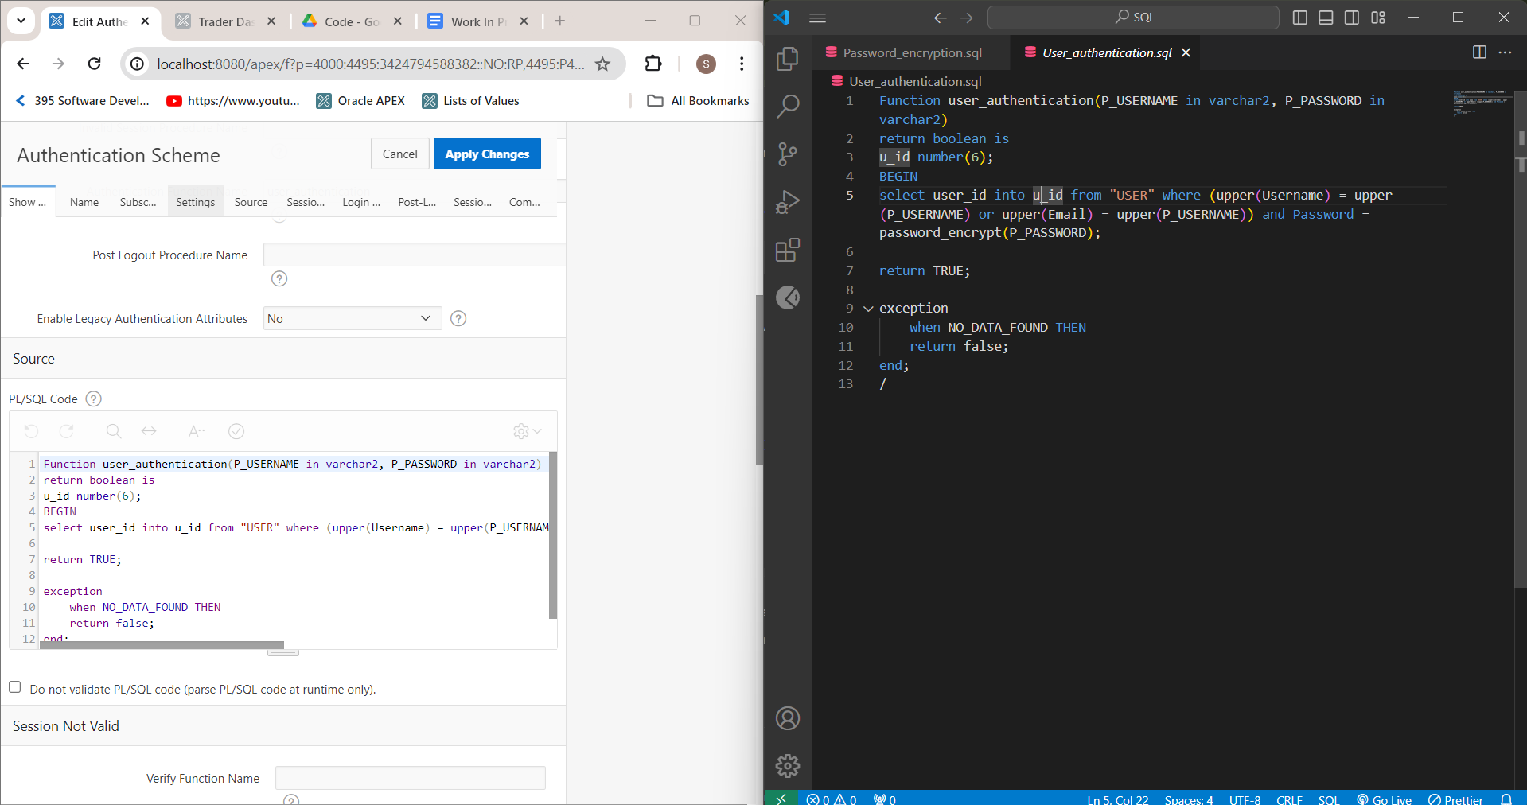
USER AUTHENTICATION

Slide 53
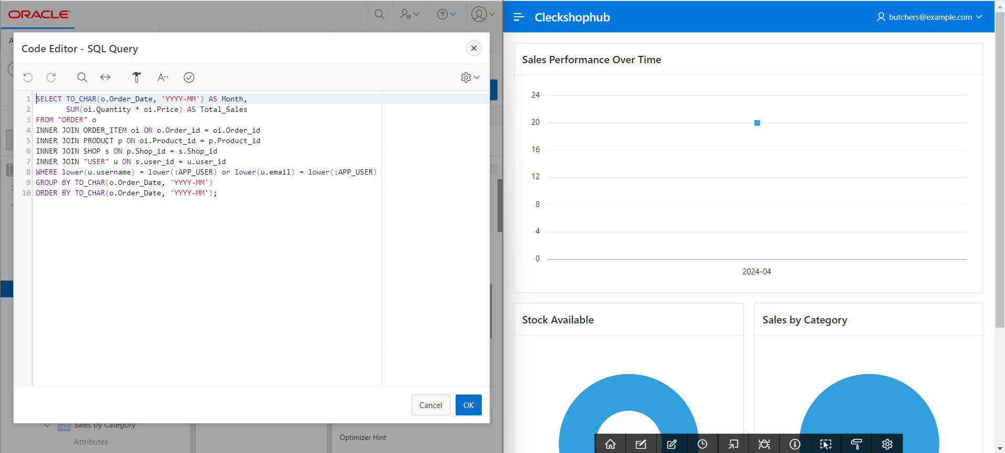
TRADER DASHBOARD

Slide 54



Thank you !

